Slide 1
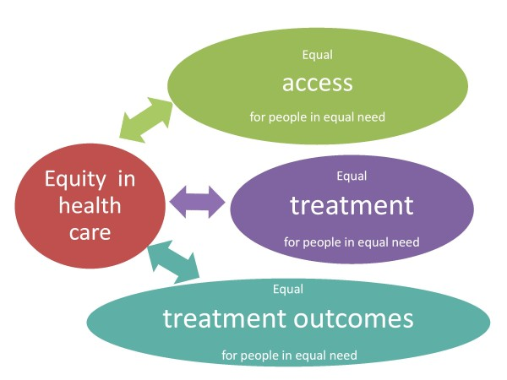
London Kidney Network
Health Equity Baseline Assessment
In 2022, the LKN Health Equity Group conducted a baseline equity assessment of access to and outcomes of renal care pathway services across the network. This slide set contain the draft equity packs for each part of the care pathway.
Any questions please email:
Catherine.croucher1@nhs.net
quality
Notes:
I

Slide 2

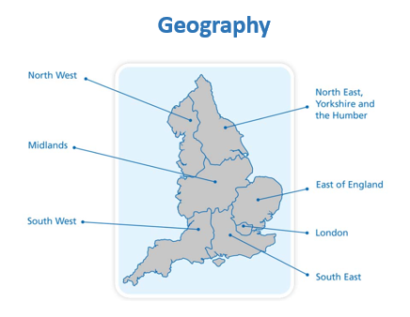


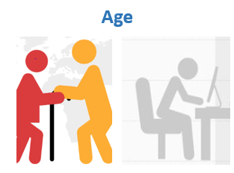
Equity Baseline Assessment
(pre-COVID, adults)
Equity of access, quality and outcomes
The population at risk of developing kidney disease
Primary Care
(CKD detection and management)
Secondary care (Nephrology Outpatients)
Specialised care
Overall RRT rates
Late Presentation
Transplant
Vascular Access
Dialysis (Home therapies)

Slide 3

London Kidney Network equity audit: key findings
Inequities found:
Older people and Peritoneal Dialysis
/transplant
Younger people and outpatient attendance/late presentation
Inequities found:
Women and CKD diagnosis / RRT
Young men and outpatient attendance/late presentation
Inequities found:
Patients from more deprived areas and:
Late presentation
Outpatient attendance
Transplant
Peritoneal Dialysis
Inequities found:
Ethnic groups other than white and outpatient attendance / transplant
On all equity metrics there was wide variation between renal centres or Integrated Care Board areas.

Slide 4
London Kidney Network
Health Equity Baseline Assessment
Section 1: Socio-demographic and clinical risk factors for kidney disease
DRAFT as @11/11/22

Slide 5
Socio-demographic and clinical risk factors for kidney disease
The rationale for risk factor selection
Age:
The risk of developing kidney disease and also requiring Renal Replacement Therapy (RRT) increases with age, with a peak in the 75-84 year age band with a median age of 64 years. (1,2)
The burden of RRT service provision (in terms of numbers) falls mostly within the 45-74 year age band. The median age for the prevalent RRT population is 60 years (2)
Ethnicity:
Crude incidence rates for RRT are higher amongst Black and Asian ethnic groups (2). Evidence for ethnic differences in CKD progression and outcomes is mixed (3). Evidence for poorer access to healthcare services in general for BME groups is reported (4).
Socio-economic status:
Crude incidence rates for RRT are higher amongst patients who live in areas categorised as more deprived (2). Evidence from research demonstrates that those who are social deprived are more likely to develop CKD than their less disadvantaged counterparts (5)
Clinical risk factors:
High blood pressure is both a leading cause of and complication of CKD. It increases the chance that kidney disease will get worse (6).
Diabetes is the leading cause of kidney failure, An estimated 40 per cent of people with both type 1 and type 2 diabetes will develop CKD during their lifetime (7)
Early stage CKD is clearly a risk for developing more advanced disease as well as being a risk factor for AKI. Albuminuria is a risk factor for faster progression of CKD as well as renal failure and CVD (8)
Frailty is prevalent in patients with CKD and it is associated with an increased risk of adverse health outcomes (9)
Mental health disorders or more common among people living with kidney disease which has consequences for their ability to adhere to treatment plans (10)
Heart failure is a significant risk factor for kidney disease (11)
See speakers notes for all references
Notes:
References
1 Health Survey for England 2016 Kidney and liver disease report
HSE2016-Adult-kid-liv.pdf (hscic.gov.uk)
2 UKRR Annual Reports and/or UKRR Data Portal https://ukkidney.org/audit-research/data-portals
3 Are people with CKD from ethnic minority groups more likely to experience faster progression and poorer outcomes than people with CKD from non-ethnic minority groups? A systematic scoping review. Kidney Research UK
Outcomes and progression of CKD in ethnic and non-ethnic minority patients (kidneyresearchuk.org)
4 The health of people from ethnic minority groups in England
The health of people from ethnic minority groups in England | The King's Fund (kingsfund.org.uk)
5 Why are people who are socially deprived more likely to develop CKD than those who are not? A systematic scoping review
Appendix_5.pdf (kidneyresearchuk.org)
6 Kidney disease and high blood pressure
Blood Pressure UK
7 Diabetes UK
Diabetes and kidney care | Healthcare professionals | Diabetes UK
8 Albuminuria Doubles Mortality Risk | National Kidney Foundation
9 Frailty and chronic kidney disease: A systematic review - PubMed (nih.gov)
10 Statement of intent Kidney disease and mental health.pdf (centreformentalhealth.org.uk)
11 Why do heart and kidney diseases go together? | BHF

Slide 6
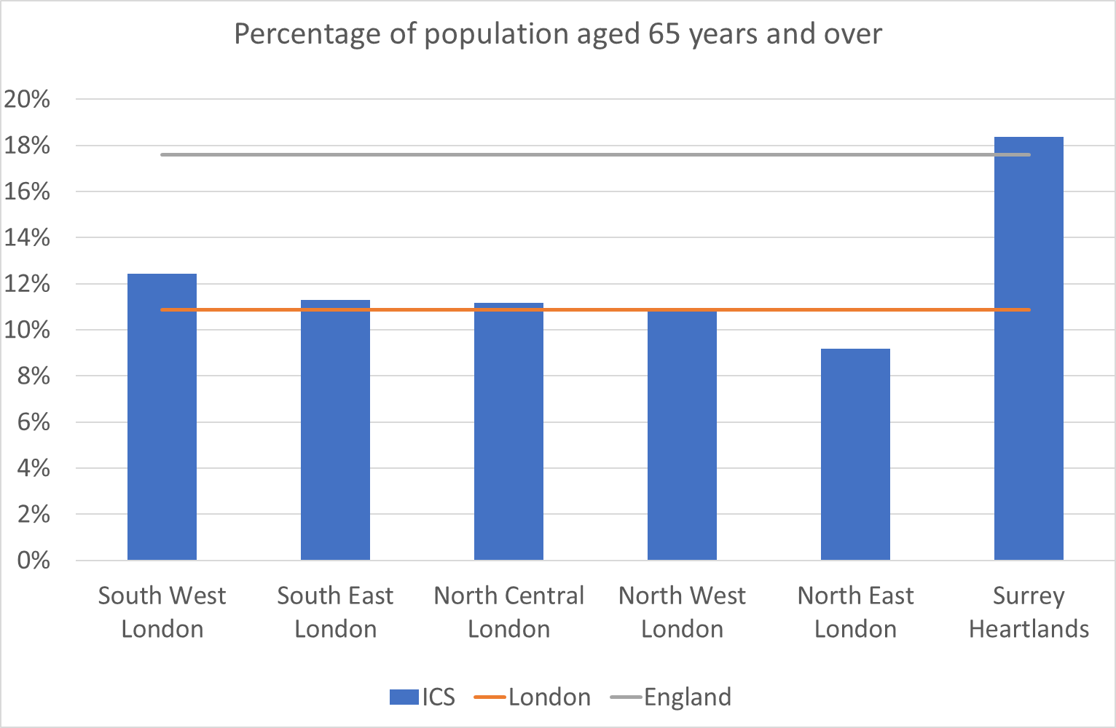
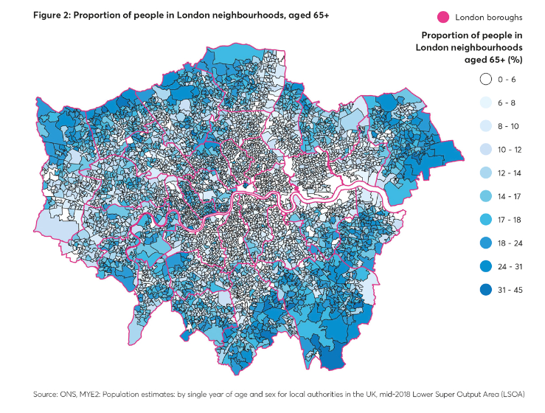
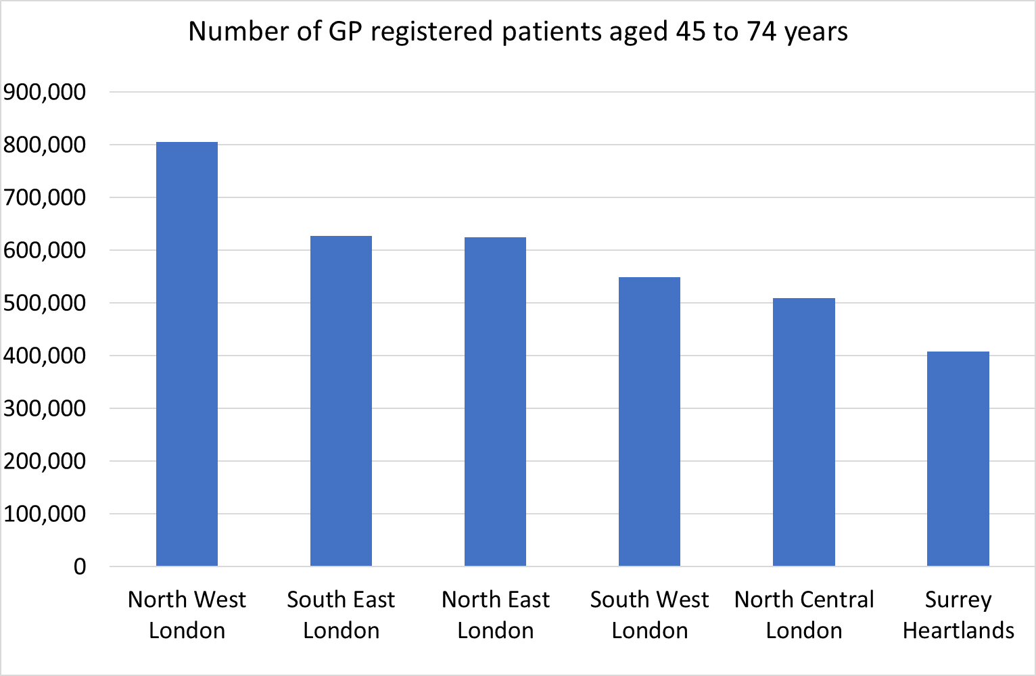
Population age-structure of London
The map below, demonstrates how the population of London varies in terms of the proportion of people aged over 65, with some areas having in excess of 30% of the population within this older age group. The two charts demonstrate age-related risk is a factor for Surrey Heartlands whereas North West London has the biggest potential for kidney disease burden in terms of absolute numbers.
Source: Primary Care Registered populations April 2020

Slide 7
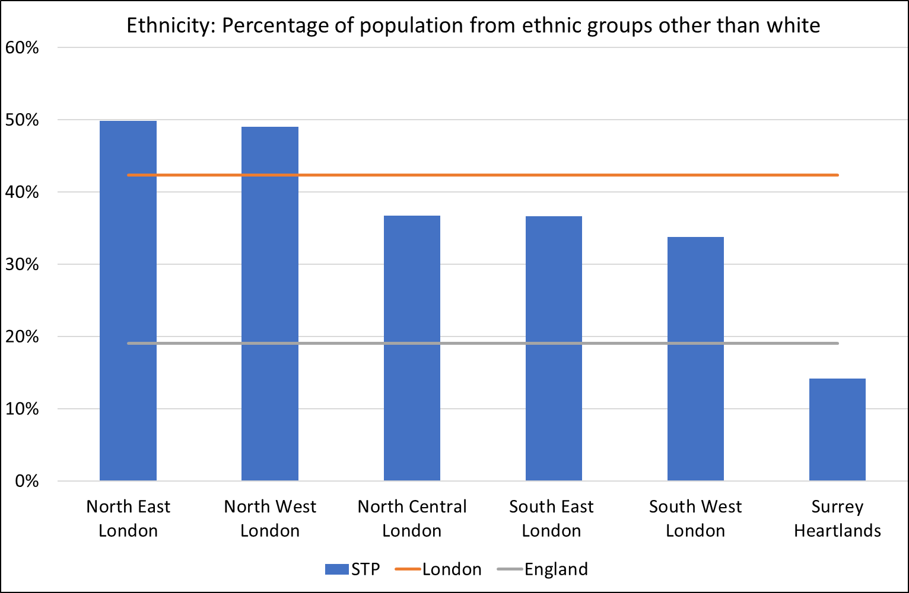
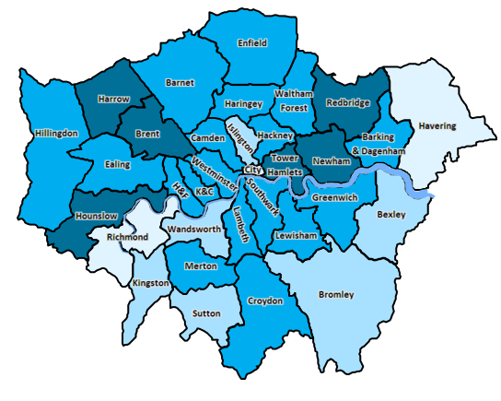
Population from an ethnic group other than white
The map below demonstrates the distribution of people of different ethnicity across London (the darker colours indicate a higher % from ethnic groups other than white).
Source: GLA ethnic group population projections 2018

Slide 8
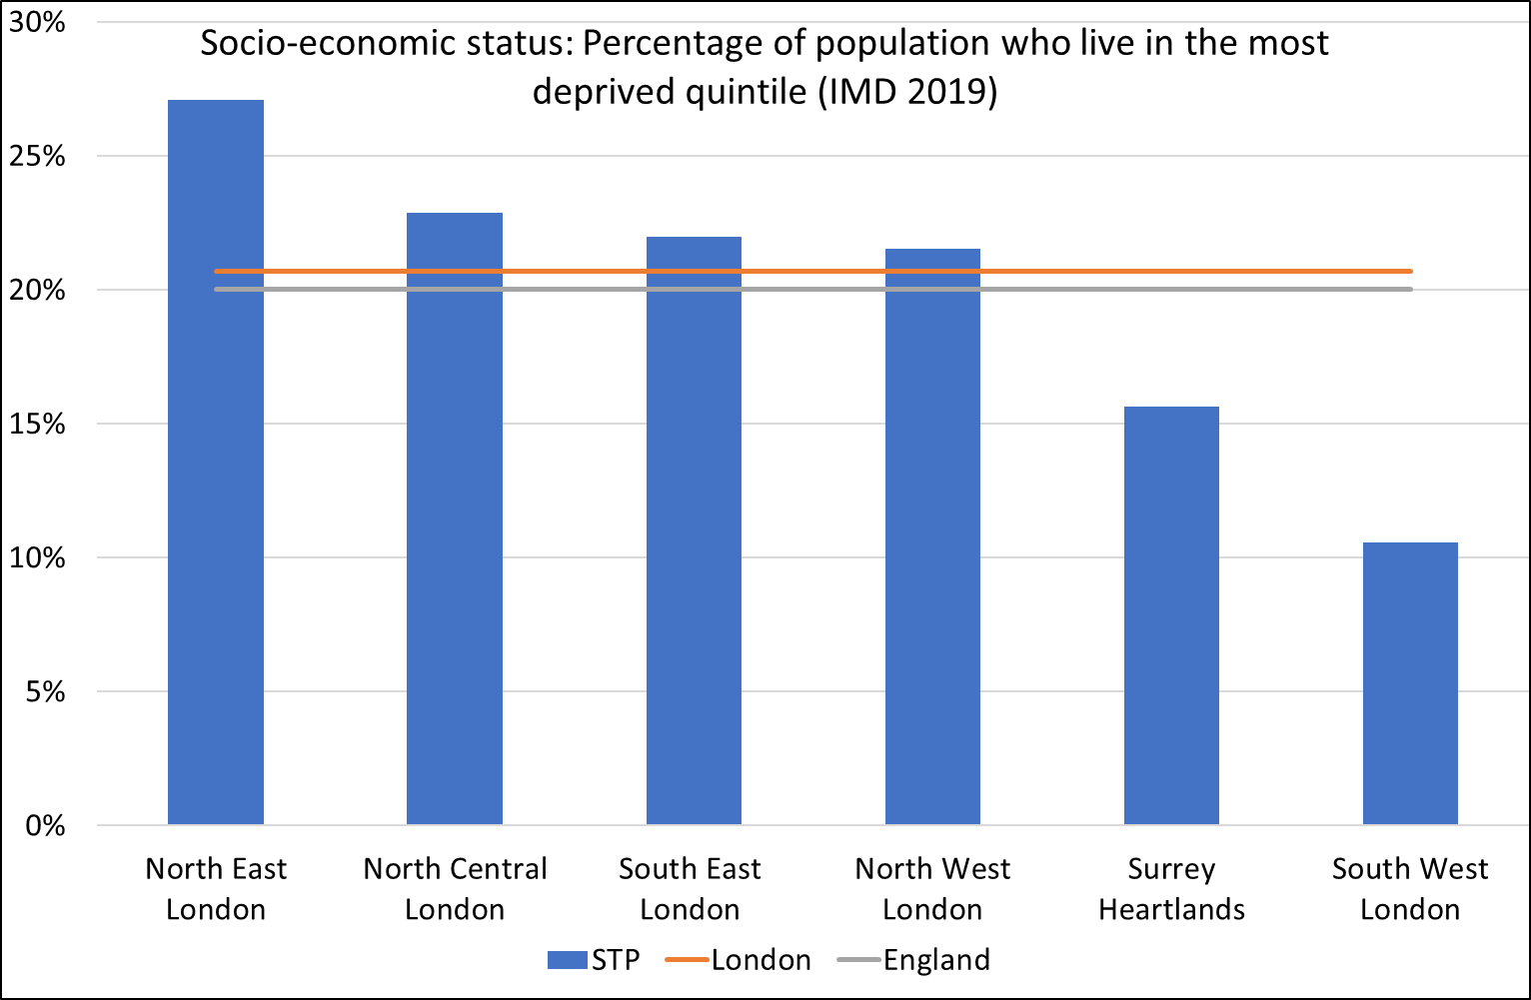
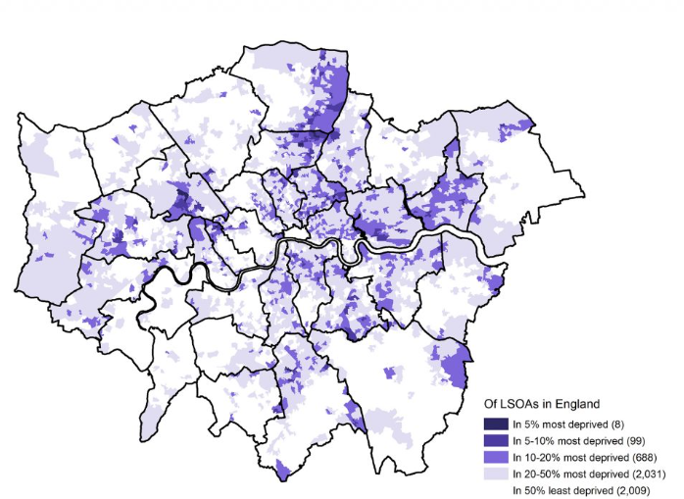
LKN Equity Audit: Population Risk factors
Socio-economic status (deprivation: based on the Index of Multiple Deprivation)
Overall, London has a similar level of deprivation to that of England as a whole. The number of neighbourhoods (LSOAs) in London among the most deprived 5% in England is eight out of a total of 4,835 LSOAs in London, or 0.2 per cent of London’s LSOAs. There are a further two per cent more (99 LSOAs) in England’s most deprived 10%.
However, in terms of relative deprivation within London, East London has a higher proportion of it’s population that live in areas categories as amongst the most deprived in the country. Surrey Heartlands and South West London are comparatively less deprived than the rest of London (and England as a whole).
The University of Sheffield, in collaboration with the Ministry of Housing, Communities and Local Government have produced IMD maps by Local Authority which can be downloaded here
LSOAs in London according to IMD 2019 deciles

Slide 9
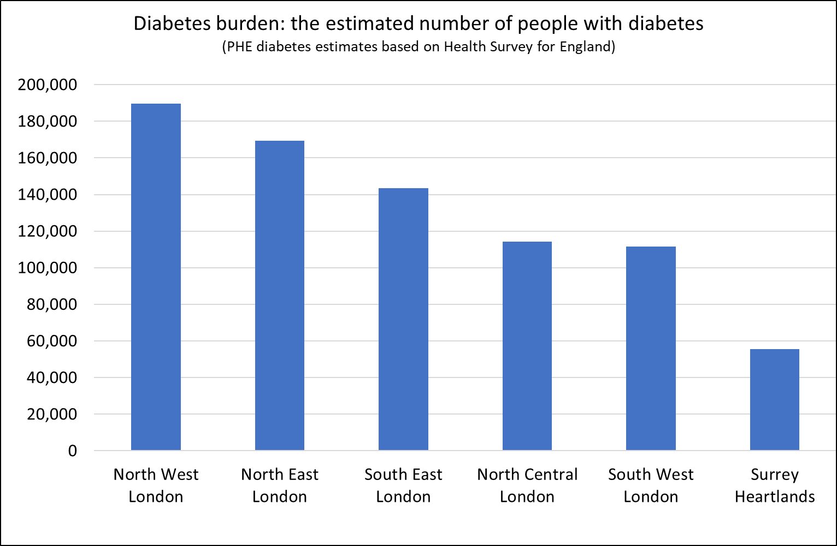
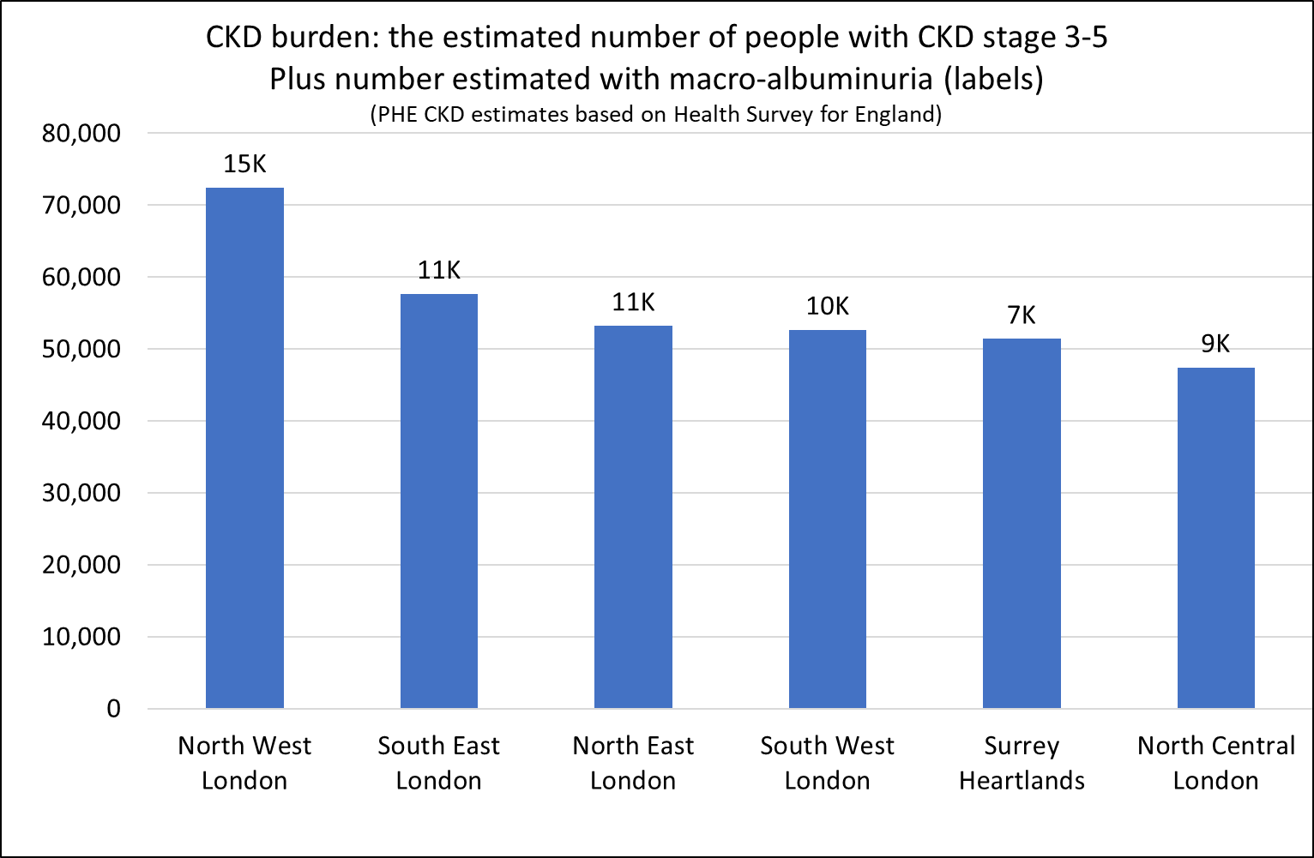
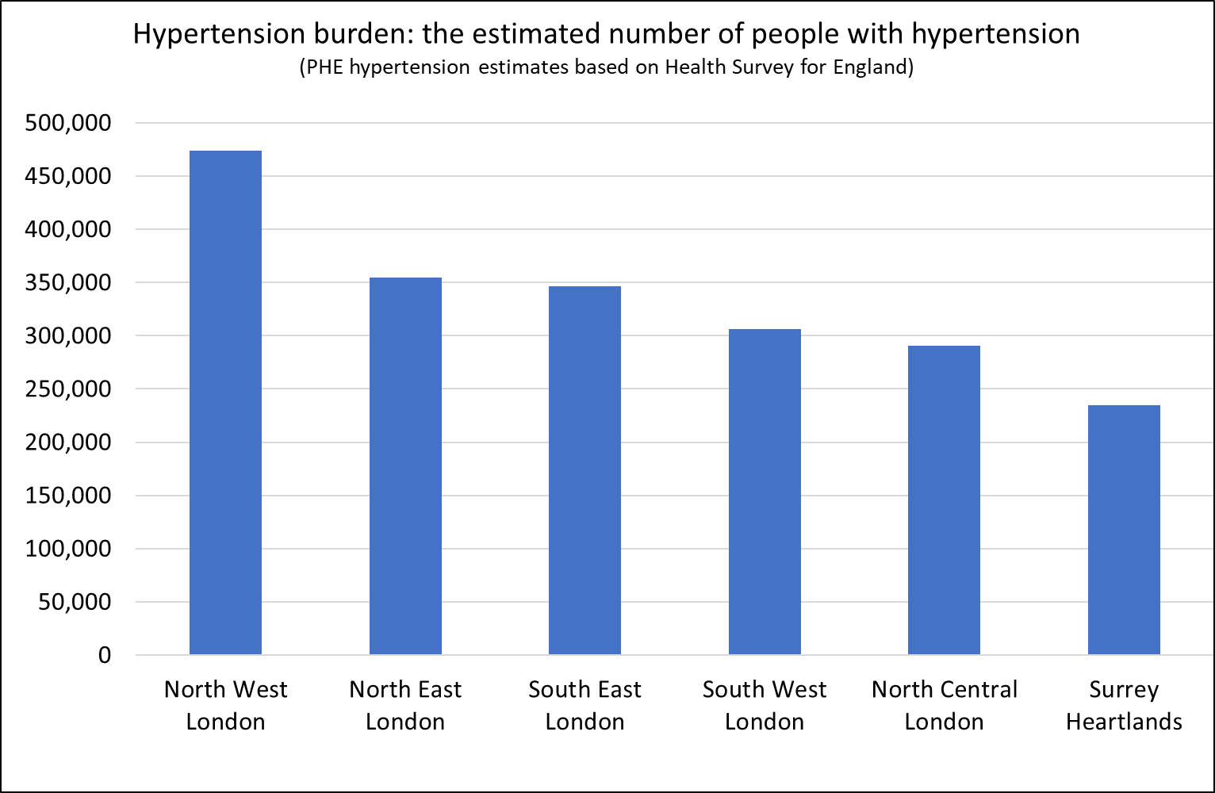
The burden of clinical risk factors
The charts show the estimated number of people to be living with CKD stage 3-5, Diabetes or Hypertension by ICS (both diagnosed and undiagnosed). These data have been estimated from national survey sources. We do not have actual data on the true prevalence of these conditions at sub-national geographies and so estimates of risk (%) cannot be shown. However, the burden (i.e. the estimated number of people) of these conditions is still of interest for service funding and planning purposes.
It can be seen that the pattern between ICSs is generally driven by a function of population size, with the more populous ICS areas having the biggest burden. The age structure of the population has been taken into account in these estimates but other factors have not, such as ethnicity and deprivation. Therefore, these estimates should be interpreted alongside the ethnicity and deprivation information on previous slides.
England prevalence: 9%
LKN prevalence: 9%
England prevalence: 5.4%
LKN prevalence: 3.7%
England prevalence: 26%
LKN prevalence: 22%
Notes:
CKD prevalence estimates: calculated by CVIN especially for the RSTP
Diabetes prevalence estimates: Diabetes prevalence estimates for local populations - GOV.UK (www.gov.uk)
Hypertension prevalence estimates: Cardiovascular Disease - OHID (phe.org.uk)

Slide 10
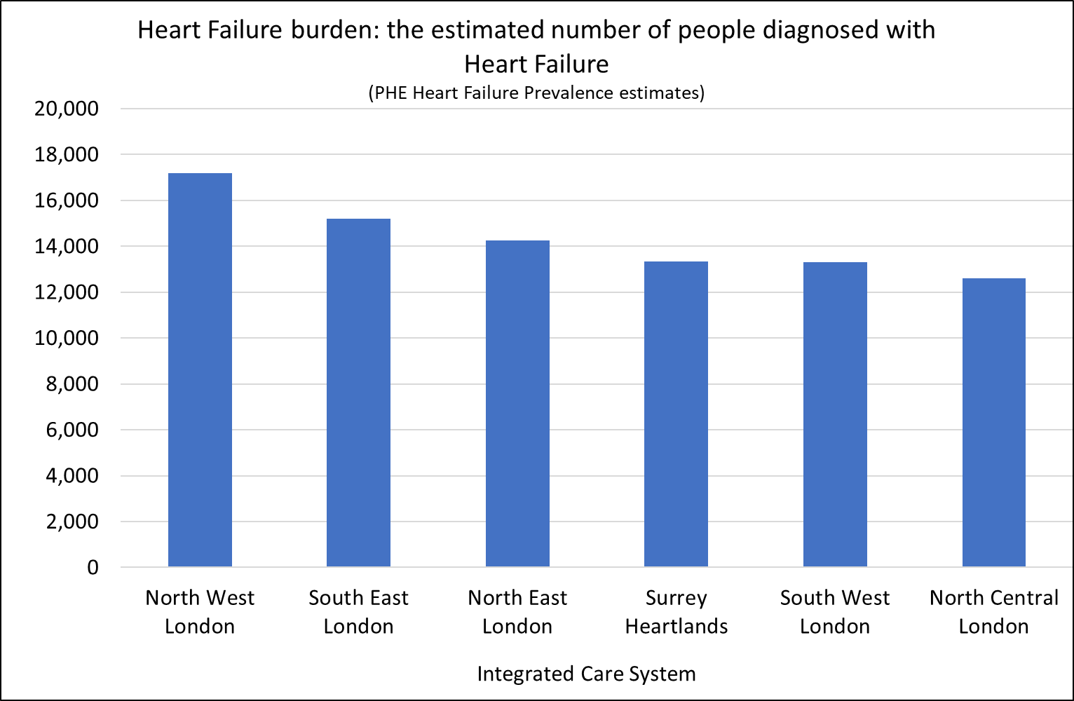
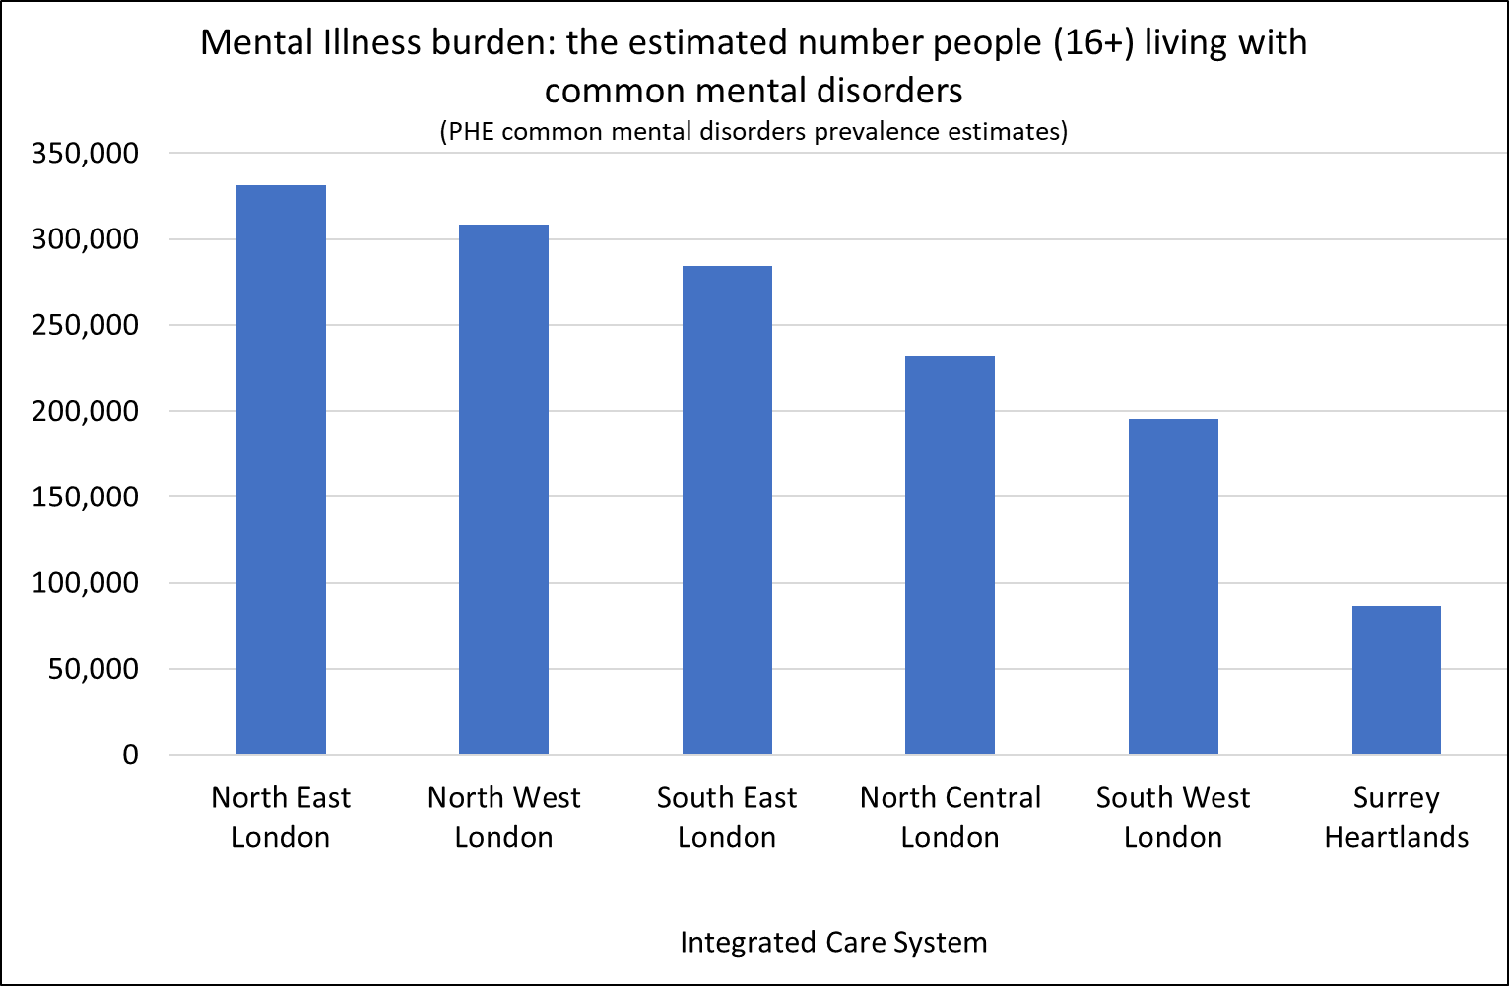
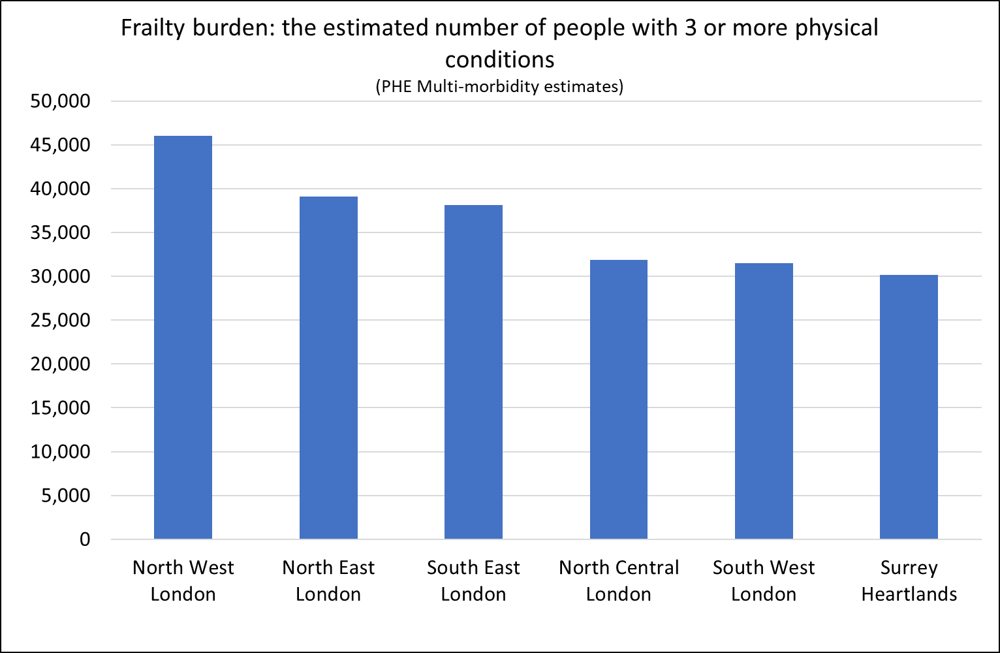
The burden of clinical risk factors (continued)
The charts show the estimated number of people to be living with frailty (multi-morbidity), Heart Failure or Mental Illness by ICS (both diagnosed and undiagnosed). These data have been estimated from national survey sources. We do not have actual data on the true prevalence of these conditions at sub-national geographies and so estimates of risk (%) cannot be shown. However, the burden (i.e. the estimated number of people) of these conditions is still of interest for service funding and planning purposes. The age structure of the population has been taken into account in these estimates but other factors have not, such as ethnicity and deprivation. Therefore, these estimates should be interpreted alongside the ethnicity and deprivation information on previous slides.
It can be seen that the pattern is generally driven by a function of population size, with the more populous ICS areas having the biggest burden. Although this is not always the case, for example, North East London is estimated to have a high burden of mental illness relative to population size.
England estimated prevalence: 1.4%
LKN estimated prevalence: 1.1%
England estimated prevalence: 17%
LKN estimated prevalence: 19%
England estimated prevalence: 3%
LKN estimated prevalence: 2%
Notes:
Heart Failure prevalence estimates: Modelled Prevalence Estimates - OHID (phe.org.uk)
Common Mental Health Disorders: Common Mental Health Disorders - OHID (phe.org.uk)
Frailty: Productive Healthy Ageing Profile - Multi-morbidity and frailty - OHID (phe.org.uk)

Slide 11
Potential barriers to access and good outcomes
Factors required to achieve good access and outcomes
Awareness of services
Travel capability
On site access
Remote access (technology)
Compliance with treatment (health literacy)
Socio-economic Education
Income/employment
Housing
Technology
Cultural
Language
Attitudes
Norms
Physical and Cognitive capacity
Physical disability
Sensory impairments
Learning difficulties
Frailty
Travel
Access to transport
Distance / rurality
Urban “islands”
Co-morbidity
Chronic conditions
Mental and emotional wellbeing
Vulnerable circumstances
Refugee/asylum status
Domestic violence
Substance misuse
Homelessness
This illustration represents some of the factors that may create barriers to being able to access services and/or achieve good health outcomes for some population groups.
Local systems may wish to explore the distribution of these factors within their populations in relation to those at risk of/requiring use of renal services. Links to the Joint Strategic Needs Assessment for each Borough have been provided in the final slide.
On the following slides, Borough level data for a selection of these factors are shown for London only.

Slide 12
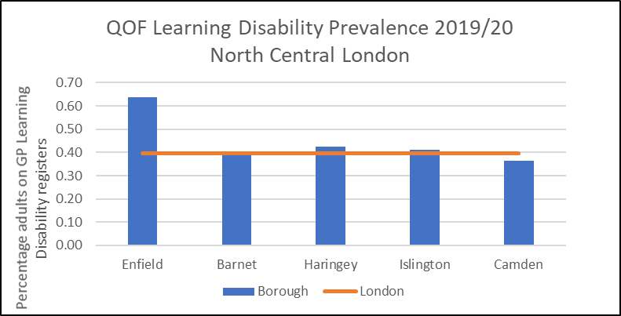
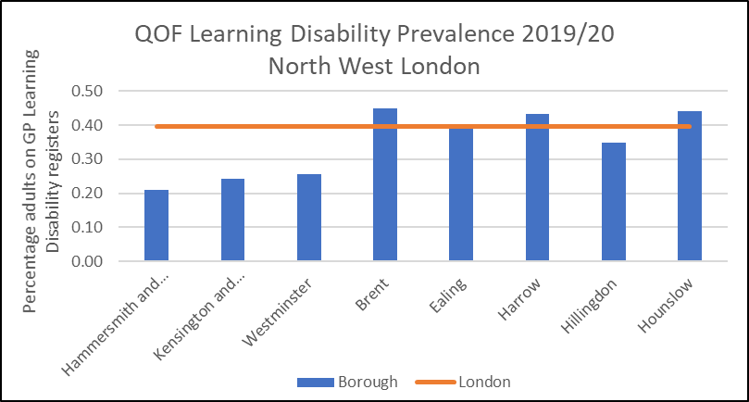
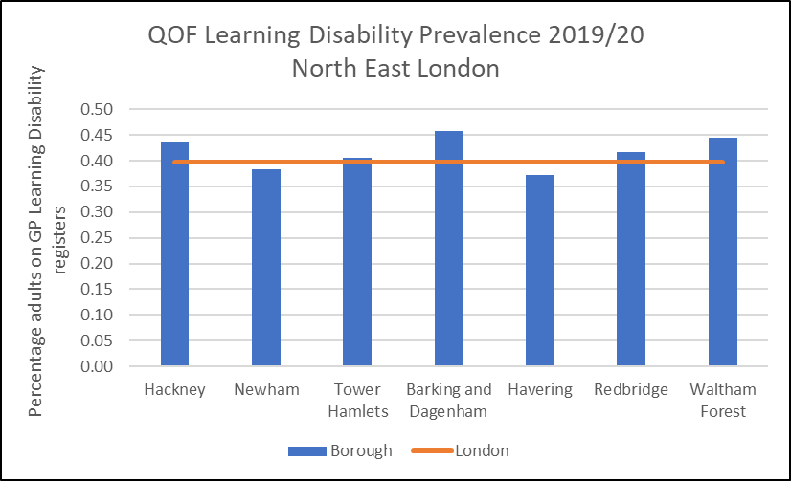
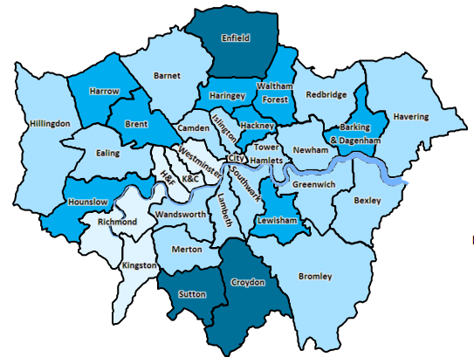
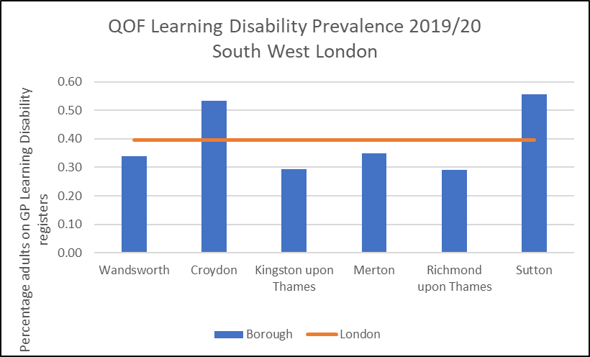
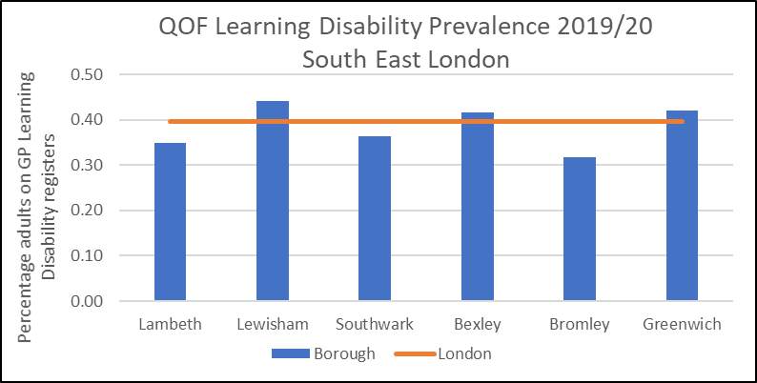
Learning Disability Primary Care Registers
Please see the Surrey JSNA for information on LD within Surrey Heartlands

Slide 13
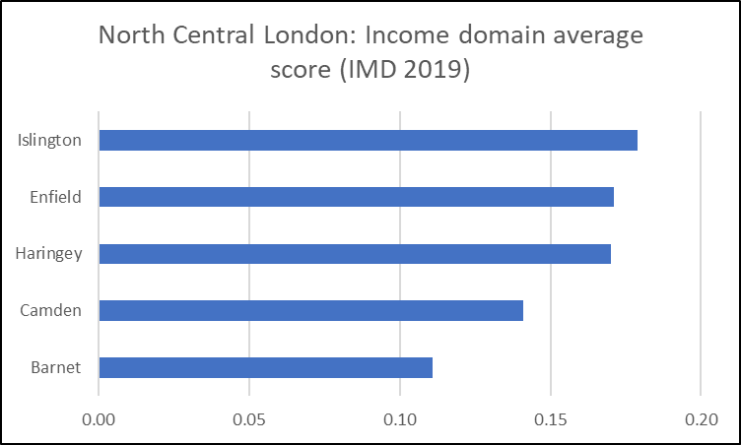
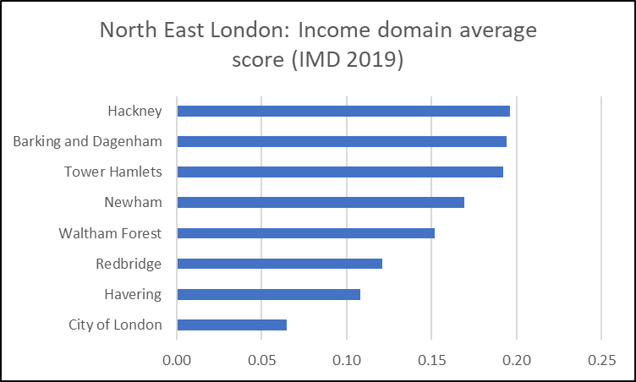
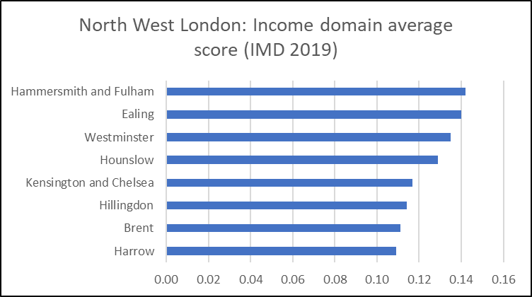
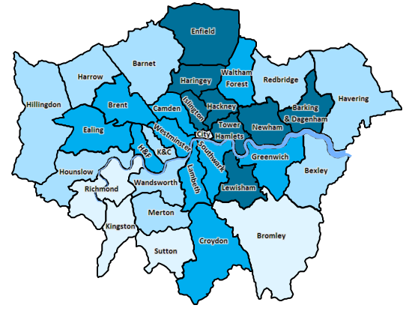
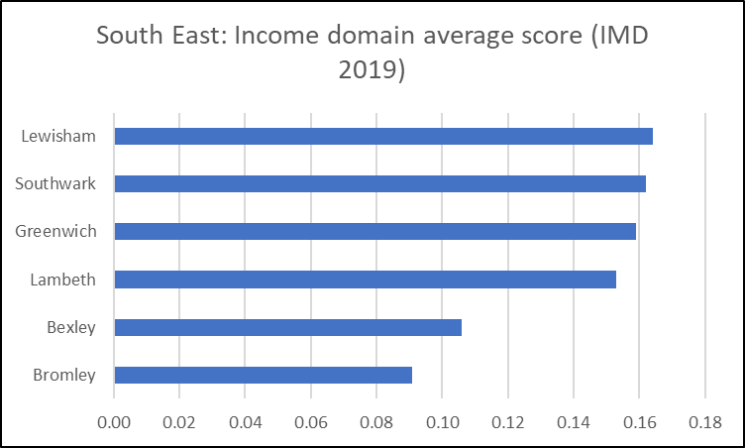
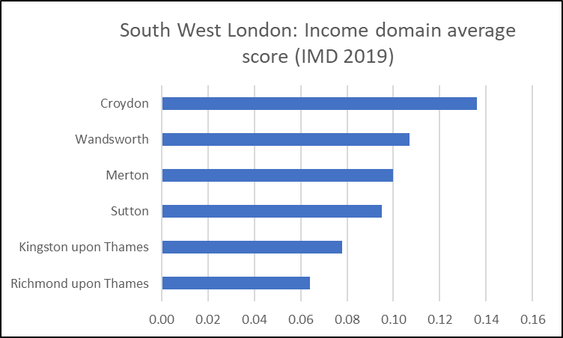
Income
The Income Deprivation Domain of the Index of Multiple Deprivation (IMD) measures the proportion of the population in an area experiencing deprivation relating to low income. The definition of low income used includes both those people that are out-of-work, and those that are in work but who have low earnings. A higher score indicates increased deprivation.
Please see the Surrey JSNA for information on employment within Surrey Heartlands

Slide 14
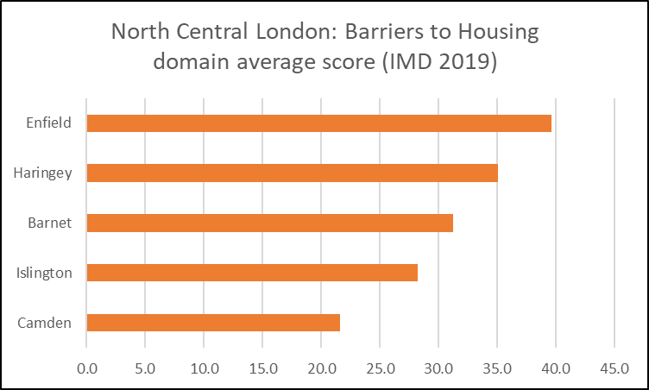
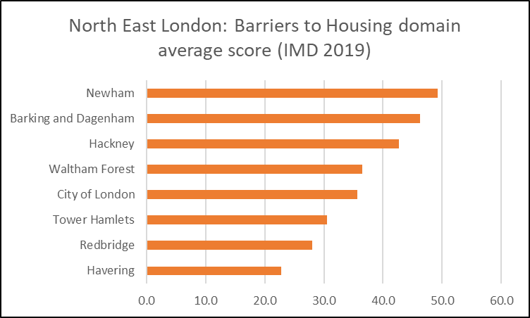
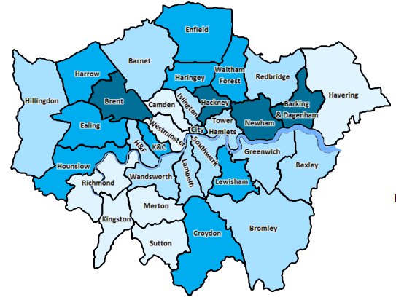
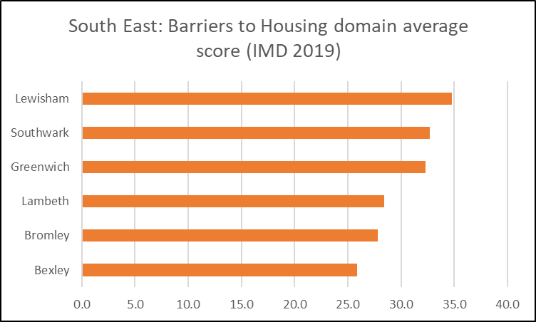
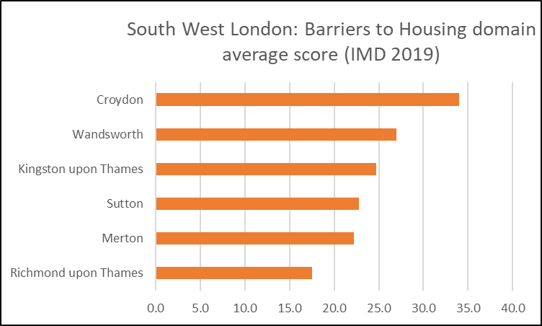
Housing and services
The Barriers to Housing and Services Domain of the IMD measures the physical and financial accessibility of housing and local services. The indicators fall into two sub-domains: ‘geographical barriers’, which relate to the physical proximity of local services, and ‘wider barriers’ which includes issues relating to access to housing, such as affordability.
Please see the Surrey JSNA for information on housing within Surrey Heartlands

Slide 15
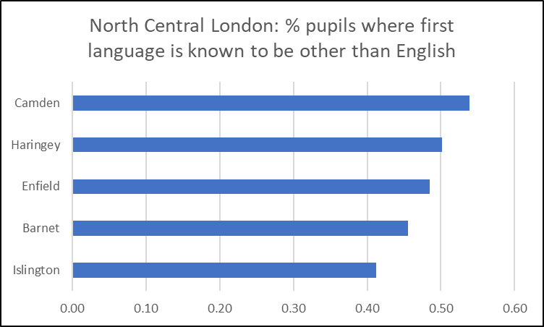
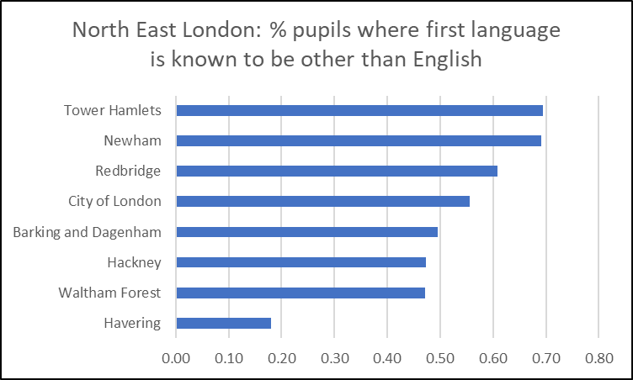
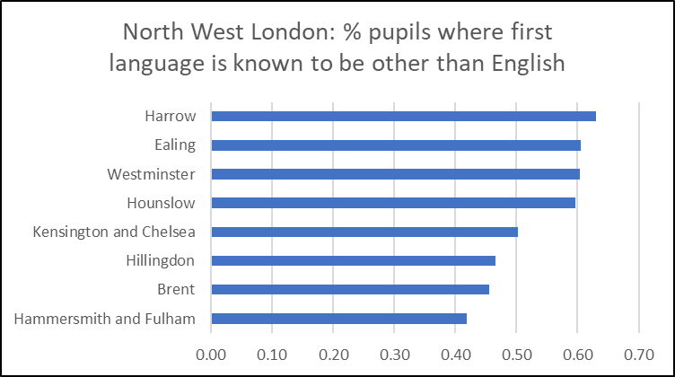
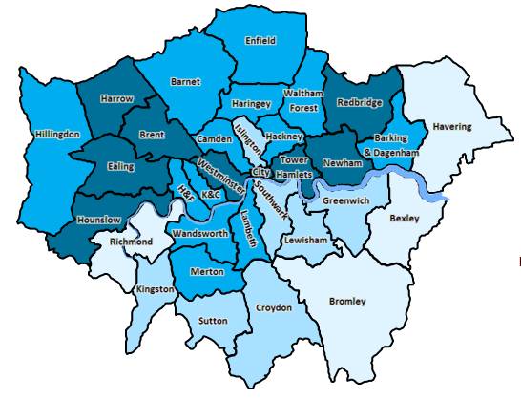
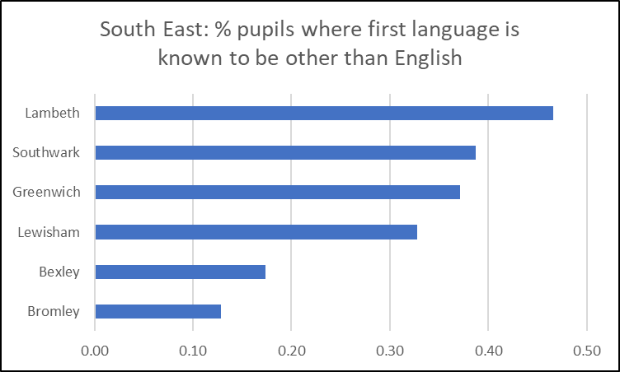
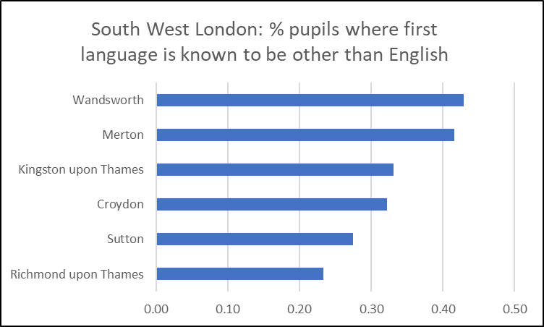
Language
The only readily available data on adults and their first language is the 2011 Census which now out of date. As a proxy for adults first language, we have analysed the School Survey 2020/21 which recorded the first language of all school pupils in England. Overall, in London, 45% of pupils have a first language other than England. Please note that this is not a direct measurement of language proficiency but only a proxy.

Slide 16
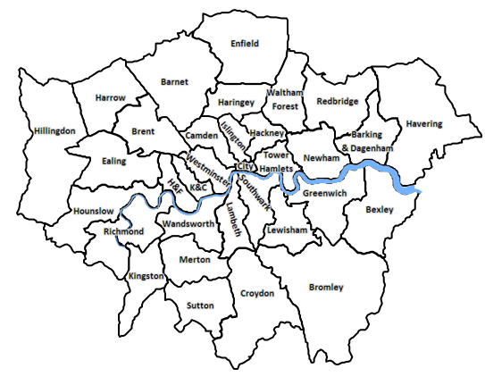
Summary: the main pattern of risk for kidney disease is that of higher need in North West London and North East London, driven by higher population numbers, higher levels of deprivation and a more diverse ethnicity structure. However, there are likely to be pockets of higher risk within ICS’s and within Boroughs. Local renal networks may wish to explore the distribution of these factors within their populations in relation to those at risk of/requiring use of renal services. London Borough public health teams and/or ICS Population Health Management teams are likely to be a good source of local data. Links to local Joint Strategic Needs Assessments are shown below
North West London | JSNA link
Hammersmith and Fulham | Joint Strategic Needs Assessment (JSNA) | LBHF
Brent | Brent Joint Strategic Needs Assessment
Hillingdon | Joint Strategic Needs Assessment - Hillingdon Council
Kensington and Chelsea | Joint Strategic Needs Assessment | JSNAs for Westminster & Kensington and Chelsea
Hounslow | Joint strategic needs assessment | London Borough of Hounslow
Westminster | Joint Strategic Needs Assessment | JSNAs for Westminster & Kensington
Ealing | Ealing's Joint Strategic Needs Assessment |
Harrow | Joint Strategic Needs Assessment (Harrow Council)
North Central London | JSNA link
Islington | JSNA | Islington Council
Barnet | Joint Strategic Needs Assessment – Barnet
Haringey | Joint Strategic Needs Assessment (JSNA) | Haringey Council
Camden | Joint Strategic Needs Assessment - Camden Council
Enfield | Joint Strategic Needs Assessment (JSNA) – Enfield
North East London | JSNA link
Havering | Havering – JSNA (haveringdata.net)
Waltham Forest | Waltham Forest JSNA Report 2014-15.pdf
Hackney | City and Hackney Health and Wellbeing Profile (cityhackneyhealth.org.uk)
Barking and Dagenham | PowerPoint Presentation (lbbd.gov.uk)
City of London | City and Hackney Health and Wellbeing Profile (cityhackneyhealth.org.uk)
Redbridge | Header (redbridge.gov.uk)
Newham | Needs Assessments – Public Health Information: Reports, Strategies and Fact Sheets – Newham Council
Tower Hamlets | Joint Strategic Needs Assessment (towerhamlets.gov.uk)
South West London | JSNA link
Richmond upon Thames | Joint Strategic Needs Assessment (JSNA) - London Borough of Richmond upon Thames
Sutton | Sutton Data – Joint Strategic Needs Assessment (JSNA)
Croydon | Croydon Observatory – JSNA
Kingston upon Thames | Kingston Data – Joint Strategic Needs Assessments
Merton | Joint Strategic Needs Assessment | Merton Council
Wandsworth | Joint Strategic Needs Assessment (JSNA) - Wandsworth Borough Council
South East London | JSNA link
Bromley | Joint Strategic Needs Assessment – London Borough of Bromley
Bexley | Bexley JSNA
Lewisham | Lewisham's Joint Strategic Needs Assessment (JSNA)
Greenwich | Joint strategic needs assessment | Royal Borough of Greenwich (royalgreenwich.gov.uk)
Southwark | (JSNA) - Southwark Council
Lambeth | Joint Strategic Needs Assessment (JSNA) | Lambeth Council

Slide 17
Renal Services Transformation Programme
Health Equity Baseline Assessment
Section 2: Renal (Kidney) Replacement Therapy
DRAFT as @11/11/22
"Do incidence rates for Renal Replacement Therapy vary by age, ethnicity, socioeconomic status or area of residence?”
This section of the RSTP Equity Assessment provides an overall summary of variation of RRT rates by demographic groups and geography. It is intended to add context to the overall assessment, rather than a judgement of equity in itself.

Slide 18
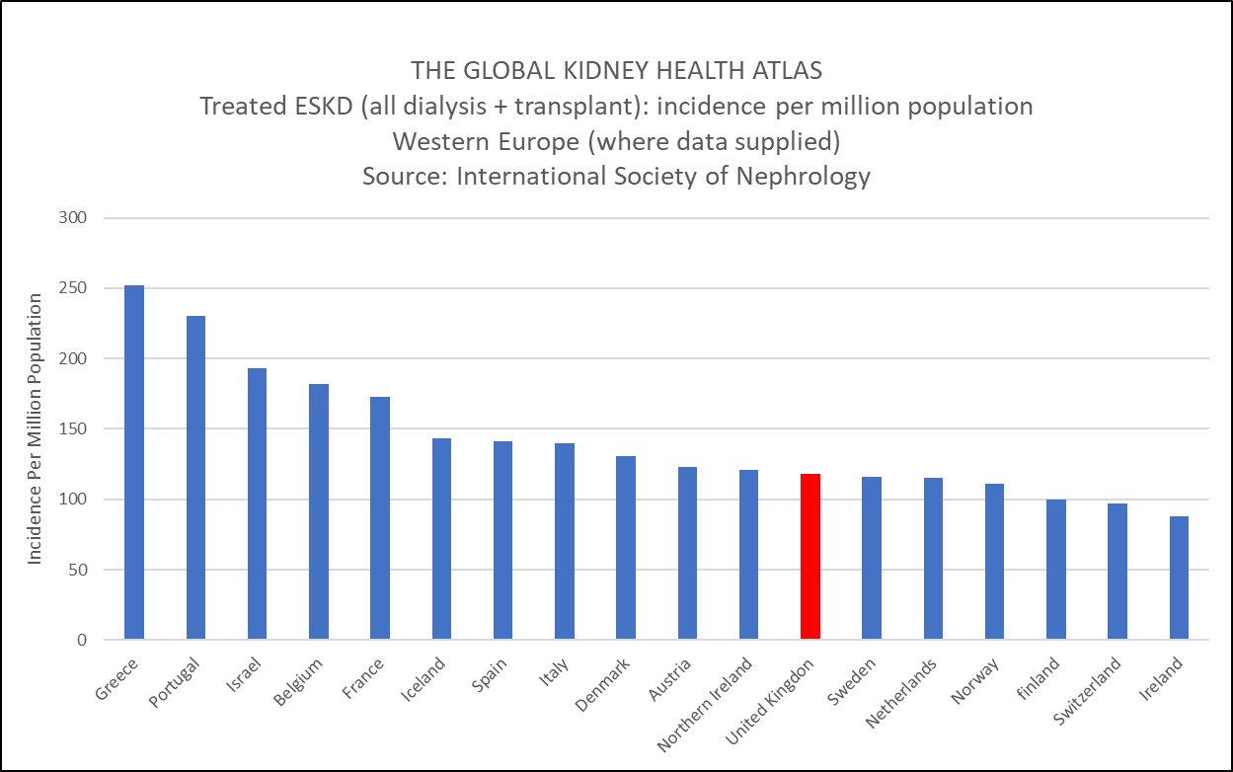
RSTP Equity: Kidney Replacement Therapy
What do we already know about overall Renal Replacement Therapy (RRT) rates?
The UKRR annual report for the year 2019 reported that the UK RRT incidence in adults was 151 per million population. The UK is shown in comparison to other Western European countries below, as reported in the Global Kidney Health Atlas.
Figure 1
Conservative Care?
One of the problems with trying to interpret differing rates of RRT is not knowing to what extent conservative care may be implemented within different population groups. This issue should be borne in mind when considering the analyses shown on subsequent slides, especially when looking at rates of RRT between different age-groups and different geographies.

Slide 19
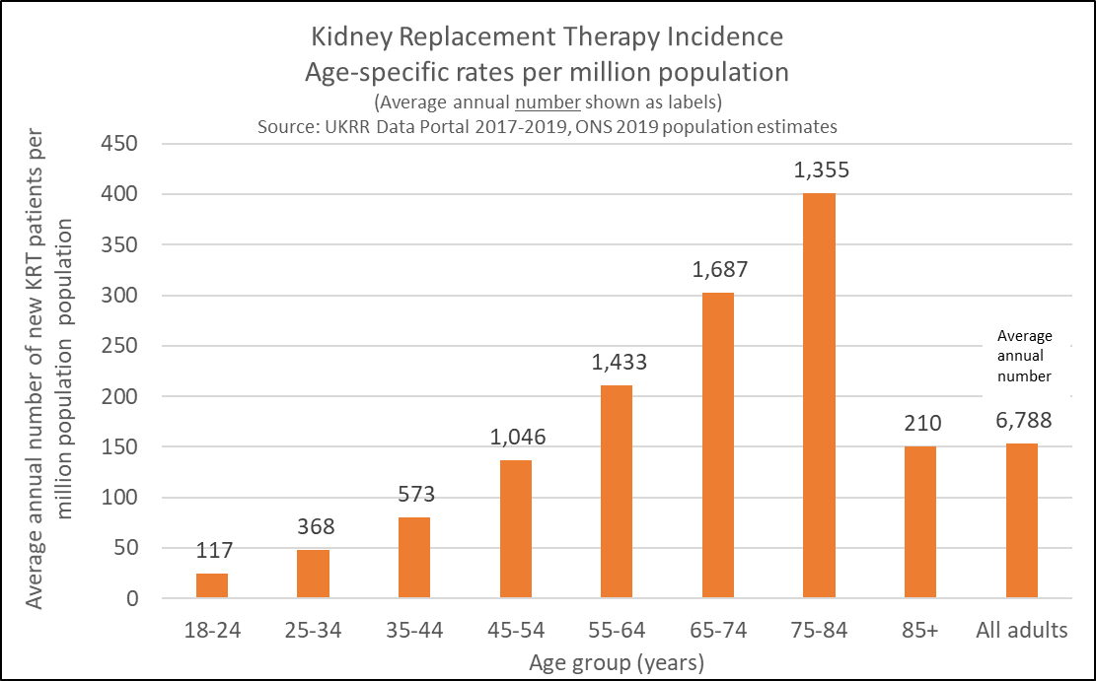
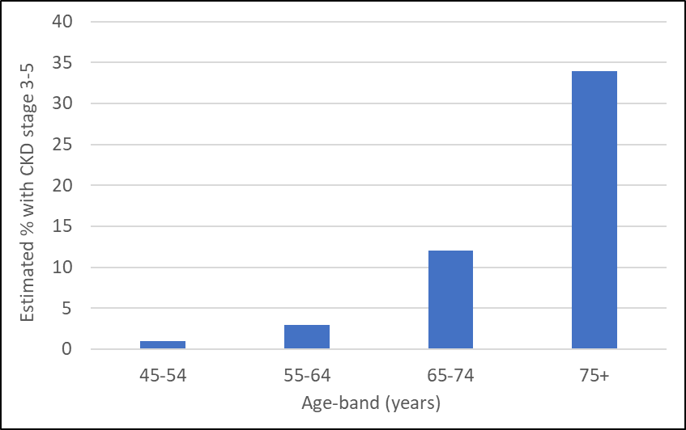
RSTP Equity Audit: Kidney Replacement Therapy
AGE: the risk of RRT
The risk of requiring RRT peaks in the 75-84 year age band (figure 2). In 2019, the median age for new RRT patients was 64 years (UKRR report 2019). The fall in RRT rates for the oldest age-group is likely to be due to the competing risks of implementing conservative care and mortality.
This pattern of increasing risk with age mirrors the estimated true prevalence of Chronic Kidney Disease (figure 3). The Health Survey for England did not report on separate age-groups above 75 years.
Figure 2: RRT age-specific incidence rates
Figure 3: Estimated prevalence of CKD (stage 3-5). Source: Health Survey for England 2016

Slide 20
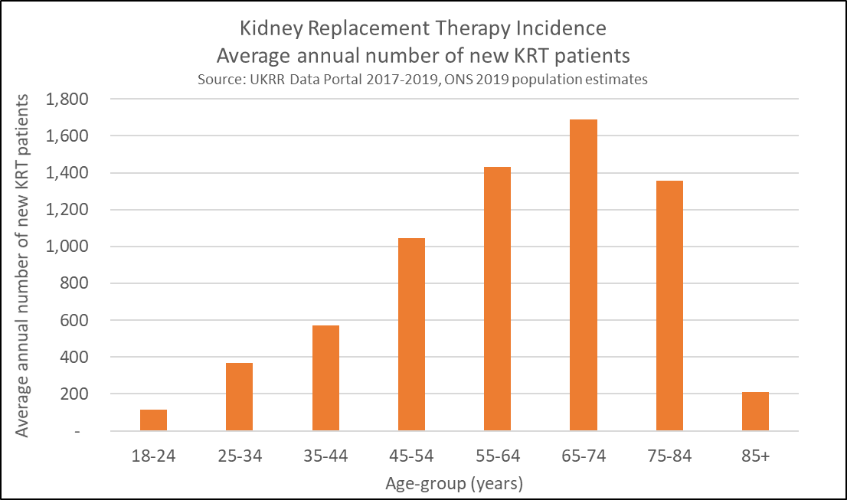
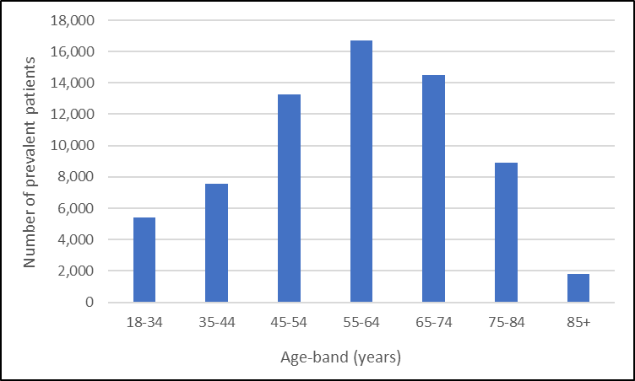
RSTP Equity: Kidney Replacement Therapy
AGE: The burden of RRT
Whilst the population based rates on the previous slide tell us about the risk of RRT, the number of RRT patients tells us about the healthcare burden of RRT provision and is useful for service planning.
In terms of new (incident) RRT patients, the largest annual numbers entering the service are seen in the 65-74 year age band (figure 4). When looking at all existing RRT patients (prevalence) , this peak is within the younger age-group of those 55-64 years (figure 5). In 2019, the median age for the prevalent RRT population was 60 years.
Figure 4
Figure 5: Number of prevalent RRT patients by age. Source: UKRR 2019 report.

Slide 21
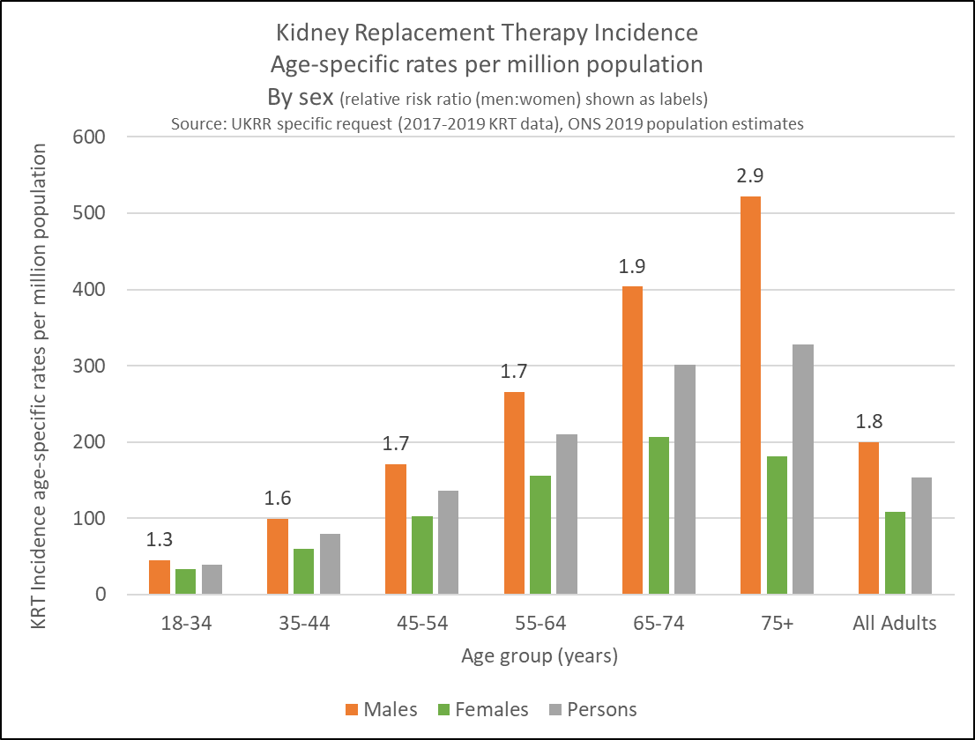
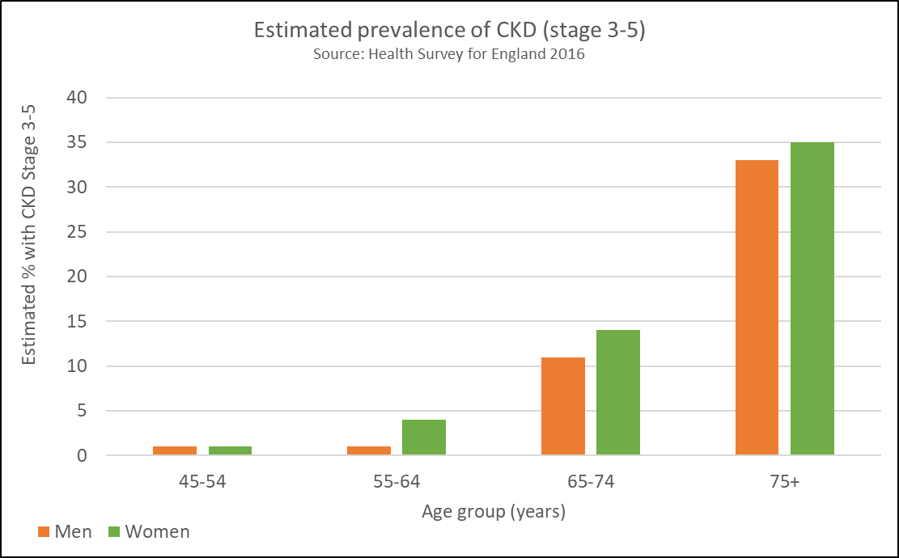
RSTP Equity: Kidney Replacement Therapy
RRT by sex
The risk of RRT is 80% higher in men compared to women for adults of all ages and this relative difference increases with each age group upto the 75+ age group where men are nearly three times as likely start RRT compared to women (figure 6). This is despite the prevalence of CKD being higher in women (figure 7). Reasons for the higher RRT rate amongst men are not well understood and likely to be multi-factorial (possibly relating to hormone differences, lifestyle and different approaches to kidney care and treatment choice).
Figure 6
Figure 7

Slide 22
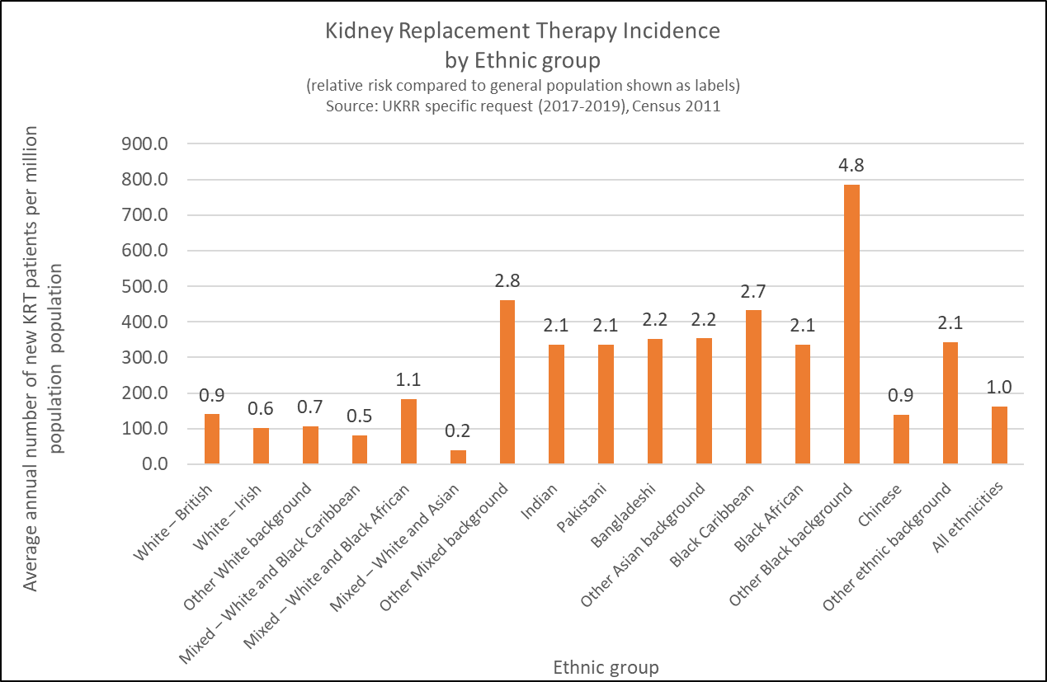
RSTP Equity: Kidney Replacement Therapy
RRT by Ethnic Group
The risk of requiring RRT is are higher for people from non-white ethnic groups and lower for those from white groups as compared to the general population (all ethnicities combined).
Summary of caveats:
This analysis uses Census 2011 data as a denominator as this is currently the only reliable source of ethnic group population by this narrow classification and age. As it is highly likely that the England population has become more diverse since 2011, RRT rates for White groups maybe artificially depressed (and vice versa for non-white group).
A) Patients from the “Other Mixed background”, “other Black background” and “Other ethnic background” categories appear to have a higher RRT rate. No further information is available regarding the characteristics of patients in these groups. However, it is highly likely that these high rates are the result of classification error i.e. patients being assigned to these “other” groups as a default rather than exploring which other categories maybe appropriate.
B) Also of note is the fact that rates for Mixed ethnic groups are lower than that of the general population (with the exception of “Mixed – White and Black African” which is similar). These lower rates do not seem realistic e.g. that someone from a “Mixed – White and Asian” group would have a much lower risk than someone from the Asian group. So again, it is likely that this is classification error.
As a result, any subsequent analysis is shown by broad ethnic group (white/black/Asian). Patients categorised as being of mixed ethnicity are assigned to the relevant main non-white category i.e. the White and Asian group would be assigned to the Asian group and so on. Therefore, the Other category in subsequent analysis is Any other Mixed Background, Chinese or Any other ethnic group.
Figure 8
See Note A
See Note A
See Note A
See Note B

Slide 23
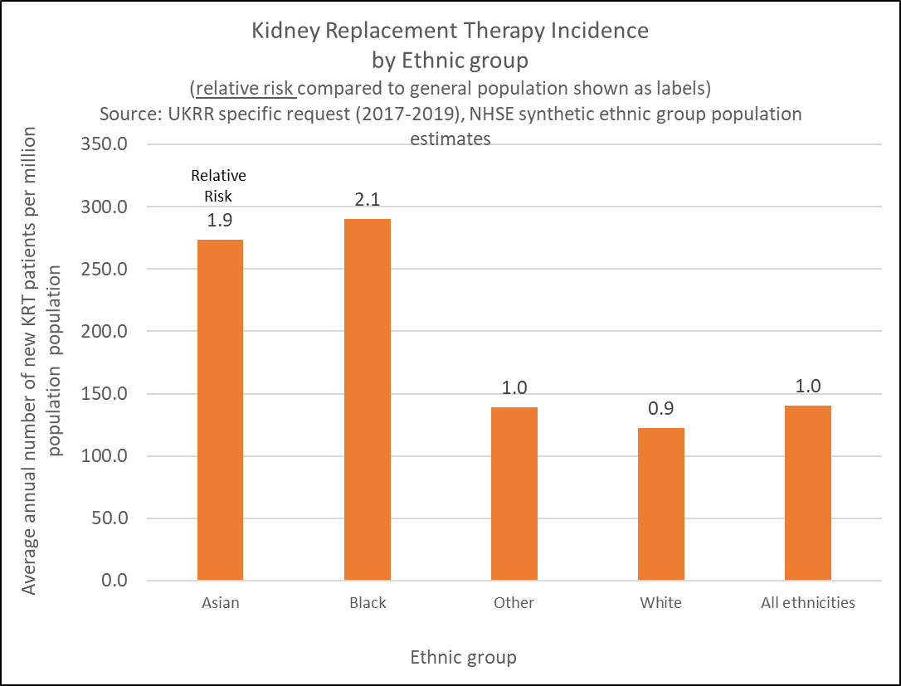
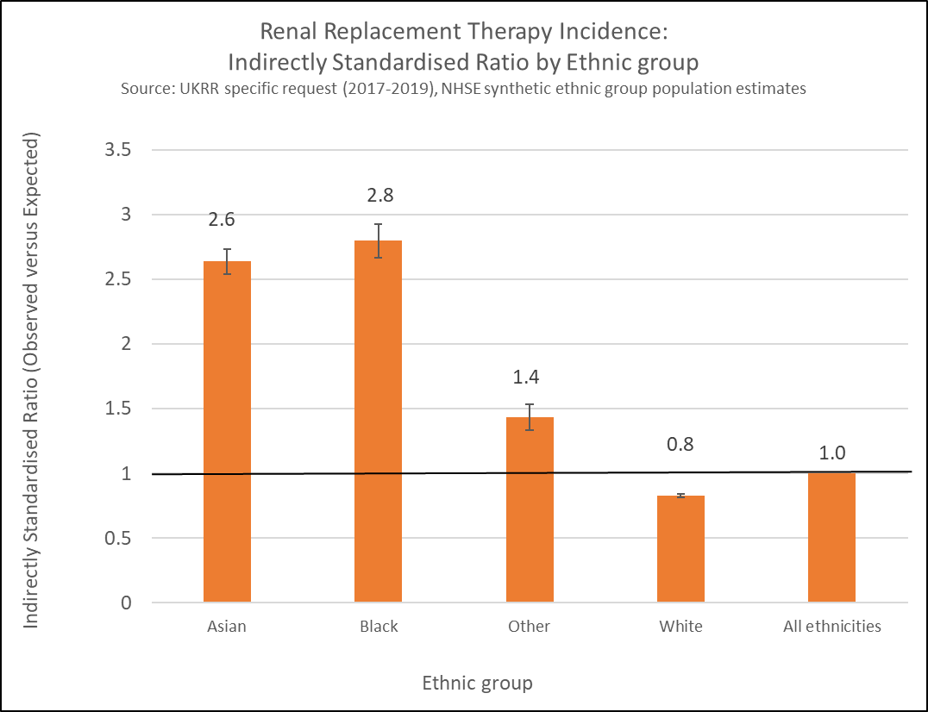
RSTP Equity: Kidney Replacement Therapy
RRT by Ethnic Group: adjusting for age
Figure 8 below shows the unadjusted incidence ratio by broad ethnic group. For this analysis we have been able to use more current population dataset as the denominator (see slide speakers notes for more detail). The higher risk of RRT for Asian and Black groups can be seen here. This pattern is also seen when looking at men and women separately (analysis not shown).
When analysing data by ethnic group is it useful to take account of the different age-structures of the white compared to non-white populations. In Figure 9 we can see that age-adjusted ratios indicate that incident RRT rates for Asian and Black ethnic groups are in fact likely to be 2-3 times higher than the general population.
Figure 9
Figure 10
Notes:
Indirectly Standardised Ratios produced using the PHE Tool for calculating common public health statistics and their confidence intervals
Synthetic primary care population estimates April 2020 Produced by Catherine Croucher, Consultant in Public Health, NHSE London Specialised Commissioning (25/06/2021)
Source data for overall patient counts: Age-sex populations for GP Practice populations as at April 2020 https://digital.nhs.uk/data-and-information/publications/statistical/patients-registered-at-a-gp-practice/april-2020
Source data for ethnic group %s: Primary Care registered Master Patient Index - September 2018 (held by NHSE national finance team: matthew.langdon@nhs.net)

Slide 24

RSTP Equity: Kidney Replacement Therapy
RRT by socio-economic status (SES)
Patients who live in areas categorised as more deprived make up a higher proportion of those new to RRT compared to those from the least deprived areas and this difference is more pronounced for the younger age-groups.
Figure 11
Age group | Absolute difference between Q1 (most deprived) and Q5 (least deprived)
18-34 | 20%
35-44 | 20%
45-54 | 18%
55-64 | 16%
65-74 | 8%
75+ | -2%
All ages | 11%
Gap:20%
Gap:11%
The confounding effect of age on RRT incidence can be seen in the older age-groups, where due to the fact that less deprived areas tend to have older populations, the relationship between RRT incidence and socio-economic status becomes less pronounced with age and then reverses in the 75+ age-group.
This implies that if the data were adjusted for age, the true additional burden of RRT amongst most deprived groups would be even higher than the 11% gap shown here for all ages.
One further point is that there will be interaction between socio-economic status and ethnicity, as areas classified as being more deprived tend to have a higher proportion of residents of from ethnic groups other than white.

Slide 25

RSTP Equity: Kidney Replacement Therapy
Geography (Integrated Care System of residence)
Figure 12
Crude RRT rates by ICS vary from 185 to 112 new patients per million population for the period 2017-2019. The rate for England was 140.
We have seen in the previous slides that unadjusted RRT rates are associated with:
Increasing age up to 74 years
% ethnicity other than white
Lower socio-economic status (% of population living areas classified as most deprived).
As a result, the next slide demonstrates variation in Observed versus Expected ratios that have been standardised to try to take account of two of these factors (age and ethnicity). It has not been possible to also adjust for SES due to lack of appropriate population denominator data.

Slide 26
ICS reference cartogram (for interpretation of next slide)

Slide 27
Observed V Expected RRT ratios by ICS (adjusted for age-sex-ethnicity)
RSTP Equity: Kidney Replacement Therapy
Figure 13: Adults aged <65 years
Figure 14: Adults aged >=65 years
 |  |  |  |  |  |  |  | 1.19 |  |  |  |  |  |  | Borders
 |  |  |  |  |  |  |  |  |  |  |  |  |  |  | STP
 |  |  |  |  |  |  | 1.00 |  |  | 1.08
 |  |  |  |  |  |  |  |  |  |  |  | 0.94
 |  |  |  |  |  |  | 1.10
 |  |  |  |  |  |  |  |  |  | 1.07
 |  |  |  |  |  | 0.93
 |  |  |  |  |  |  |  |  |  | 1.15 |  | 1.15
 |  |  |  |  |  |  | 0.97 |  |  | 1.04
 |  |  |  |  |  | 1.11 |  |  |  |  |  | 0.97
 | Low | Med | High |  |  |  | 1.13 |  | 0.92
 | 0.73 | 1.00 | 1.19 |  |  | 1.00 |  |  |  | 1.01
 |  |  |  |  |  |  | 1.02 |  |  | 0.95 |  |  | 0.88
 |  |  |  |  |  |  | 1.05 | 0.86 |  | 0.96 |  | 0.97
 |  |  |  |  |  |  | 0.91 |  |  |  |  | 0.99
 |  |  |  |  |  | 1.07 |  |  |  | 1.08 |  |  |  | 1.07
 |  |  | 1.02 | 1.05 | 1.01
 | 0.94 | 0.90 | 0.99 | 0.99 |  |  | 0.96 |  | 0.77 |  | 1.05 |  | 1.07
 |  |  |  |  |  |  | 0.73
 |  |  |  |  |  |  | 0.91
 |  |  |  |  |  |  |  | 1.03 |  |  |  |  |  |  | Borders
 |  |  |  |  |  |  |  |  |  |  |  |  |  |  | STP
 |  |  |  |  |  |  | 0.83 |  |  | 0.74
 |  |  |  |  |  |  |  |  |  |  |  | 0.90
 |  |  |  |  |  |  | 1.04
 |  |  |  |  |  |  |  |  |  | 1.20
 |  |  |  |  |  | 0.88
 |  |  |  |  |  |  |  |  |  | 0.91 |  | 0.77
 |  |  |  |  |  |  | 0.96 |  |  | 0.96
 |  |  |  |  |  | 1.38 |  |  |  |  |  | 0.93
 | Low | Med | High |  |  |  | 1.05 |  | 1.09
 | 0.74 | 0.98 | 1.45 |  |  | 0.86 |  |  |  | 1.13
 |  |  |  |  |  |  | 1.19 |  |  | 0.95 |  |  | 0.80
 |  |  |  |  |  |  | 1.08 | 1.12 |  | 1.17 |  | 0.84
 |  |  |  |  |  |  | 0.99 |  |  |  |  | 1.11
 |  |  |  |  |  | 0.90 |  |  |  | 1.01 |  |  |  | 1.12
 |  |  | 0.94 | 1.01 | 1.07
 | 1.45 | 1.21 | 0.92 | 0.88 |  |  | 0.96 |  | 0.97 |  | 1.13 |  | 0.91
 |  |  |  |  |  |  | 0.94
 |  |  |  |  |  |  | 1.12
Source: UKRR 2017-2019
Source: UKRR 2017-2019
To try to minimise the effects of the unknown levels of conservative care, O:E ratios were calculated for under-65s and 65-and-overs separately, expecting that unknown levels of conservative care will be more of an issue in the older age group. See slide notes for standardisation methodology.
Dark blue shaded ICSs have significantly higher observed than expected and light blue shaded have significantly lower observed than expected. It can be seen that most ICSs have an O:E ratio that falls within the expected range for the <65’s (figure 13). In analysis not shown, the <65’s O:E ratios were positively associated with increasing deprivation. It is difficult to interpret the over 65 analysis due to the unknown levels of conservative care that may be in place in each area (figure 14).
Please see speakers notes for O:E ratio methodology
Notes:
O:E methodology
RRT incidence observed-expected ratios (indirect standardisation).
Observed cases (Oi) were calculated by summing all cases in all age-sex-ethnic group bands for each STP.
Expected cases (Ei) for each STP were calculated as follows:
Overall crude rates (for each year) were calculated for the whole covered population (England) by summing the observed numbers, over all the ICSs, for each age-sex-ethnic group band and dividing this by the total population in that age-sex-ethnic group. These crude rates (by age-sex-ethnic group band) were then multiplied by the population each ICS had in each band.
These expected numbers were then summed over the age-sex-ethnic group bands to give an expected total number of cases in each ICS. The age/sex/ethnic group standardised ratio for ICS is then O/E. The expected number of cases is therefore the number seen if the rates in the standard population are applied to that individual STP’s age-sex-ethnic group breakdown.
An O/E Standardised Ratio of 1 indicates that the area’s rate was as expected; a value above 1 indicates that the observed rate was greater than expected given the area’s population structure. If the lower confidence limit was above 1 this was statistically significant at the 5% level. The converse applies to ratios below 1.

Slide 28
RSTP Equity: Interpreting RRT rates by geography
The population
Renal Replacement Therapy
Observed V Expected ratios by ICS (adjusted for age-sex-ethnicity)
Possible interpretations of O:E ratios
Higher than expected O:E ratio
Poor diagnosis/referral from primary care resulting in more patients progressing to RRT than necessary
AND/OR especially low use of conservative care
AND/OR population characteristics associated with higher risk of RRT that can not be adjusted for in this analysis.
Lower than expected O:E ratio
Poor diagnosis/referral from primary care resulting in a lower than appropriate number of patients receiving RRT
AND/OR especially high use of conservative care
AND/OR
Population characteristics associated with lower risk of RRT that can not be adjusted for
Undiagnosed CKD
Observed RRT
Diagnosed but uncoded CKD
In-centre Dialysis
Home therapies
Transplantation
Expected RRT
(based on population demographics)
In-centre Dialysis
Home therapies
Transplantation
Diagnosed and coded CKD (i.e. QoF CKD register)
Stage 4-5
Stage 3
Late presentation
Timely referral
NICE. Chronic kidney disease in adults: assessment and management Clinical guideline [CG182]
Conservative Care?
Conservative Care?

Slide 29
RSTP Equity: Kidney Replacement Therapy
Variation in Renal Replacement Therapy Incidence rates: summary
The incidence rate of RRT increases with increasing age with a peak in the 75-84 year group. However, in terms of absolute numbers, most new RRT patients are within the 65-74 year group and when looking at everyone currently on RRT (prevalence), this group has a younger profile again, with the median age being 60 years.
Incident RRT rates for Asian and Black ethnic groups are 2-3 times higher than the general population.
Incident RRT rates are 11% higher for patients from areas classified as being in most deprived in England, compared to the least deprived. This gap is widest for younger patients (18-44 years) where the gap is 20%.
Incident RRT rates by ICS areas vary from 185 to 112 new patients per million population. The rate for England was 140. Interpretation of RRT rates by geography is complex as we cannot take account of influences such as deprivation and levels of conservative care. When looking at those aged under 65 years, the majority of ICS areas fall within expected limits.

Slide 30
Renal Services Transformation Programme
Health Equity Baseline Assessment
Section 3: Identification and management of Chronic Kidney Disease in Primary Care
DRAFT as @11/11/22
“Are people with chronic kidney disease in England, identified in a timely manner and managed according to best practice, irrespective of age, ethnicity, socioeconomic status or geography?”

Slide 31





Renal Equity Audit: What do we already know about the diagnosis and management of CKD in primary care?
CKD Coding:
Audit authors estimated that between 5.5% and 5.8% of the adult population in England and Wales have CKD stage 3-5
Overall approximately 4.2% of adults have an appropriate CKD stage 3-5 code
Around 1.2% of the adult population have clear evidence of CKD 3-5 on blood tests but don’t have a code
ACR testing:
54% of CKD who have diabetes received the relevant annual urine tests
For other groups ACR rates are below 30%
Blood Pressure Management:
Overall, 54.6% of patients met target BP based on their last recorded measure.
Lipid control:
The audit found that 68.8% of those with CKD had been prescribed statin medication

Slide 32

Renal Equity Audit: Primary Care
Primary Care analysis: Data source
CVDPREVENT is a national audit of GP records to support primary care in understanding how many people with cardiovascular disease (CVD), or conditions that lead to a higher risk of developing CVD, are potentially undiagnosed, under treated or over treated. Home | CVDPREVENT
% of patients with recorded CKD
% of patients with evidence of CKD in medical record but not present on CKD register (uncoded CKD)
% people on CKD register with an uACR test in last 12 months
% people on CKD register with an eGFR test in last 12 months
% people on CKD register with an ACR of less than 70 mg/mmol with controlled blood pressure
% people on CKD register with HTN and proteinuria who are currently treated with RASi
% people on CKD register with a previous prescription for lipid lowering therapy
Data analysis methods:
Analysis by age/sex/ethnic group/deprivation: crude (unadjusted) rates with 95% Confidence Intervals
Analysis by Integrated Care System: Indirectly Standardised Ratios adjusted for age and sex (calculated using PHE’s Tools for calculating common public health statistics and their confidence intervals)

Slide 33

The London Kidney Network Equity audit
This pack has been produced for the national Renal Services Transformation Programme. Within it there are London Kidney Network specific data at ICS level for all of the metrics.
Further breakdown of the metrics for individual ICS’s can be viewed via the CVD-Prevent Data Explorer tool.
CKD diagnoses and uncoded CKD are available at ICS level
ACR testing, eGFR testing and therapies are available at PCN level and GP Practice level.
The analysis here reveals three key points for the LKN:
East London has a higher than expected number of patients diagnosed with CKD stage 3-5 (given it’s population age-structure)
North West London and North Central London have better rates of CKD identification (i.e. less patients with uncoded CKD)
North West London and North Central London have better rates ACR testing amongst those diagnosed with CKD.
Local Renal Networks may wish to use the Data Explorer tool to further understand identification and management of CKD in their areas.

Slide 34


Prevalence of recorded CKD diagnosis*
Renal Equity Audit: Primary Care
In March 2020, the overall prevalence of recorded CKD for England was 3.9% (compared to 4.2% in the 2017 CKD Audit).
Recorded CKD is higher amongst women compared to men
Recorded CKD is strongly associated with older age.
Recorded CKD appears to be slightly higher amongst those from less deprived areas. However, this is likely to be due to the confounding effect of age; less deprived areas tend to have older populations and as a result will have higher CKD prevalence rates. We are not able to adjust for population age-structure using the CVD-Prevent data.
An ethnic group breakdown was not available as part of the metric.
*Prevalence of GP recorded Chronic Kidney Disease with classification of categories G3a to G5 (previously stage 3 to 5) in patients aged 18 and over

Slide 35
The impact of COVID-19 on recorded CKD prevalence
(March 2020 vs. Sept 2021)
Renal Equity Audit: Primary Care
On average across England, recorded CKD prevalence fell by 0.2% in absolute terms (a relative change of 6%).
The East of England and South West regions saw the biggest falls in CKD recording, whilst London saw a much smaller difference pre and post COVID.
This could reflect changes in CKD ascertainment practice, clinical service reorganization, changes in health-seeking behaviour during the pandemic as well as the impact of COVID-related mortality amongst the CKD population.
 |  | Mar-20 (%) | Sep-21 (%) | Absolute change | Percentage change after COVID
Gender | Male | 3.3 | 3.1 | -0.2 | -5.53*
 | Female | 4.6 | 4.3 | -0.3 | -6.04*
Age | 18-39 (All) | 0.1 | 0.1 | 0.0 | -1.82
 | 40-59 (All) | 0.9 | 0.9 | -0.1 | -6.97*
 | 60-79 (All) | 8.0 | 7.4 | -0.6 | -7.38*
 | 80+ | 30.0 | 28.6 | -1.3 | -4.42*
Deprivation | 1 - most deprived | 3.6 | 3.3 | -0.2 | -6.65*
 | 2 | 3.7 | 3.4 | -0.2 | -6.02*
 | 3 | 4.0 | 3.8 | -0.2 | -5.55*
 | 4 | 4.3 | 4.0 | -0.3 | -6.20*
 | 5 - least deprived | 4.2 | 4.0 | -0.2 | -5.10*
Region | Mar-20 (%) | Sep-21 | Absolute change | Percentage change after COVID
East of England | 3.4 | 3.2 | -0.2 | -7.0
London | 2.4 | 2.3 | -0.1 | -2.6
Midlands | 4.7 | 4.4 | -0.3 | -6.2
North East & Yorkshire | 4.2 | 4.0 | -0.2 | -5.0
North West | 4.4 | 4.2 | -0.2 | -5.3
South East | 4.0 | 3.8 | -0.2 | -5.8
South West | 4.8 | 4.4 | -0.4 | -7.5
Prevalence of GP recorded Chronic Kidney Disease with classification of categories G3a to G5 (previously stage 3 to 5) in patients aged 18 and over

Slide 36

Renal Equity Audit: Primary Care
Prevalence of recorded CKD diagnosis stages 3-5, by Integrated Care System (ICS), September 2021
Indirectly Standardised (for age and sex) Ratio (ISR)
The ISR’s shown below indicate the ratio between the observed CKD prevalence and the CKD prevalence that would be expected in each ICS, if they had the same age-specific prevalence rates as England overall.
It is a way of accounting for the different age-sex population structures in each ICS. For example, an ISR of 120, means that the CKD prevalence in that ICS is 20% higher than we would expect
It has not been possible to adjust for ethnicity or deprivation in this analysis.

Slide 37

Uncoded CKD*
Renal Equity Audit: Primary Care
Overall, across England, 0.7% of adult patients had biochemical evidence of having CKD stage 3-5 (as indicated by two eGFR results) but had no record of a CKD diagnosis. This compares to 1.2% in the 2017 CKD Audit.
Levels of uncoded CKD are strongly associated with increasing age (more than 5% of those aged 80+ may have undiagnosed CKD) and are higher amongst women.
They are also higher amongst less deprived populations but this is likely to be due to the confounding effect of age.
*The percentage of GP registered patients aged 18 and over with two estimated glomerular filtration rates (eGFRs) <60ml/min/1.73m2 more than 3 months apart, indicating possible missed diagnosis of CKD categories G3a to G5 (previously stage 3 to 5), but with no record of CKD categories G3a to G5 diagnosis in the GP record. All eGFR readings are 3 or more months prior to the audit end date

Slide 38

Renal Equity Audit: Primary Care
Uncoded CKD by Integrated Care System (ICS), September 2021
Indirectly Standardised (for age and sex) Ratio (ISR)

Slide 39

Late presentation* and uncoded CKD
There is a moderate strength positive correlation between the percentage of patients with uncoded CKD and those who present late to specialised renal services.
Renal Equity Audit: Primary Care
*a patient is deemed to have presented late to renal services where there is less than 90 days between the date first seen by the specialised renal service (typically in an Advanced Kidney Care Clinic) and the date of Renal Replacement Therapy start.

Slide 40

Albumin-Creatinine Ratio testing*
Renal Equity Audit: Primary Care
Overall, across England, 23.5% of registered CKD patients had a record of having had an ACR test in the preceding 12 months. This is similar to the findings of the 2017 CKD Audit.
ACR testing rates were lower amongst younger age-groups, women and less deprived populations.
Although testing rates were higher amongst men overall, in the 18-39 year age-group, testing rates were lower amongst men compared to women (13.9% versus 15.3% (data not shown, see CVD-Prevent data explorer tool). This could be associated with higher late presentation rates in younger men (see Late Presentation section)
ACR testing rates were higher amongst those from Asian ethnic groups. This could be associated with lower late presentation rates in Asian patients (see Late Presentation section)
*Percentage of patients aged 18 and over with GP recorded CKD with a record of a urine albumin:creatinine ratio (or protein:creatinine ratio) test in the preceding 12 months to September 2021

Slide 41

Renal Equity Audit: Primary Care
ACR testing by Integrated Care System (ICS), September 2021
Indirectly Standardised (for age and sex) Ratio (ISR)

Slide 42




Estimated Glomerular Filtration Rate (eGFR) testing*
Renal Equity Audit: Primary Care
Overall, across England, 80% of registered CKD patients had a record of having had an eGFR test in the preceding 12 months.
eGFR testing rates increase with increasing age
There is little variation in testing rates between men and women or between different socio-economic groups
eGFR testing rates were slightly higher (although still significant) amongst patients from Asian ethnic groups, compared to white ethnic groups. All other ethnic groups have lower rates than the white group
*Percentage of patients aged 18 and over with GP recorded CKD (G3a to G5), with a record of an eGFR test in the preceding 12 months. As at March 2022

Slide 43

eGFR testing by Integrated Care System (ICS), March 2022
Indirectly Standardised (for age and sex) Ratio (ISR)

Slide 44




Blood Pressure Control*
Renal Equity Audit: Primary Care
Overall, across England, 63% of registered CKD patients, with an ACR of less than 70 mg/mmol, had their blood pressure under control
Blood Pressure control rates were highest in the 60-79 year age group and in men compared to women
There is little variation in testing rates between different socio-economic groups
Blood Pressure control rates are better amongst those from Asian ethnic groups, compared to white ethnic groups.
*Percentage of patients aged 18 and over with GP recorded CKD (G3a to G5) with an ACR of less than 70 mg/mmol, in whom the last blood pressure reading (measured in the preceding 12 months) is less than 140/90 mmHg.

Slide 45

Blood pressure control by Integrated Care System (ICS), March 2022
Indirectly Standardised (for age and sex) Ratio (ISR)

Slide 46

Renal Equity Audit: Primary Care
Management of CKD:
% RASi: Percentage of patients 18+, with recorded CKD, hypertension and proteinuria, currently being treated with renin-angiotensin system antagonists
% statin: percentage of patients 18+ with recorded CKD, with a previous prescription for lipid lowering therapy
For England overall:
67.9% of eligible patients were treated with RASi
RASi therapy is fairly consistent between demographic groups
74.6% of eligible patients have been treated with a lipid-lowering therapy (compared to 68.8% in the 2017 CKD Audit)
Lipid-lowering therapy increases with age, is higher amongst men, those from Asian ethnic groups and those from more deprived areas
Please see appendix A for ICS charts

Slide 47

Renal Equity Audit: Primary Care
RASi therapy by Integrated Care System (ICS), September 2021
Indirectly Standardised (for age and sex) Ratio (ISR)

Slide 48

Renal Equity Audit: Primary Care
Lipid-lowering therapy by Integrated Care System (ICS), September 2021
Indirectly Standardised (for age and sex) Ratio (ISR)

Slide 49
Renal Equity Audit: Primary Care
Summary of main findings
CKD Diagnosis: Being diagnosed with CKD stage 3-5 is more likely for patients who are:
Older (80+)
Female
Blood pressure management is:
Worse among younger patients
Worse among women
Better among Asian groups
eGFR testing is:
Worse among younger patients Better among Asian groups
Uncoded CKD: having undiagnosed CKD is more likely for patients who are
Older (80+)
Female
Uncoded CKD is associated (at the ICS level) with rates of late presentation to specialised renal services
RASi therapy is:
fairly consistent between demographic groups
ACR testing is:
Worse among younger patients (<60)
Worse among women
Better among Asian groups
Lipid management is:
Worse among younger patients (<60)
Worse among women
Better among Asian groups
Better among more deprived groups
Analysis by Integrated Care System:
There is considerable variation in CKD coding rates and ACR testing rates between regions and ICS areas

Slide 50
Renal Equity Audit: Appendix A
ICS Code reference table

Slide 51
London Kidney Network
Health Equity Baseline Assessment
Section 4: Equity Analysis of Nephrology Outpatients
DRAFT as @11/11/22
“What are the patterns of attendance, non-attendance, cancellation and mode of attendance between patients of different ages, ethnicity, socioeconomic status or area of residence?”
Analysis supported by Lauren Powell (NHS Arden & Greater East Midlands CSU)

Slide 52
Nephrology Outpatient analysis: Data source
Secondary User Service plus (outpatient data): all nephrology outpatient appointments during 2019/20 (first appointments only)
(2019/20 was chosen in order to be able to assess equity before the impact of the COVID-19 pandemic)
Denominator for attendance rates: ONS mid-year population estimates 2019
Denominator for attendance mode / DNA / cancellations: all outpatient appointments (first appointments only)
Data analysis methods:
Crude (unadjusted) rates with 95% Confidence Intervals
Data quality (England):
7% of patients within this dataset did not have their ethnicity recorded.
12% had their ethnicity recorded as “Other ethnic groups”
If we compare these proportions to the 2011 Census, it seems likely that patients have been erroneously assigned to the “other” category as this group only makes up 1% of the resident population of England. We would expect the proportion of Nephrology patients from White ethnic groups to be lower than that of the general population (and higher amongst patients from groups other than white) due to the differing risk of developing kidney problems between ethnic groups. However, the proportion of White patients is quite a bit lower than the Census and those from Asian or Black ethnic groups only slightly higher. This suggests that patients from all of these groups may have been erroneously assigned to the “Other category” (or not had their ethnicity recorded at all) but there is no way of knowing the distribution of this assignment error. This makes interpretation of analysis by ethnic groups difficult and caution should be applied.
 | SUS Nephrology Outpatients (England) | 2011 Census (England)
White | 65% | 86%
Asian or Asian British | 9% | 8%
Black or Black British | 5% | 3%
Mixed | 1% | 2%
Other ethnic groups | 12% | 1%
Not recorded | 7%

Slide 53




Nephrology Outpatient attendance rates
Caution: Poor ethnicity coding means interpretation is difficult

Slide 54

Nephrology Outpatient attendance rates by ICS/Provider
It can be seen that the largest volumes of nephrology outpatient first attendances are at Imperial, the Royal Free and King’s College Trusts. These volumes drive higher attendance rates for the respective ICS areas.
East London and Surrey Heartlands have much lower attendance rates due to low volumes at Barts and St. George’s. There is one non-renal centre (London North West) with more than >1k nephrology outpatient attendances in the year.

Slide 55




Nephrology Outpatient Mode of Attendance
Caution: Poor ethnicity coding means interpretation is difficult

Slide 56


Nephrology Outpatient Mode of Attendance by ICS and Provider
Across the London Kidney Network, the percentage of outpatient appointments that are delivered as non face-to-face is less than half the national rate.
Barts and Epsom St Helier have much higher rates of non face-to-face outpatient appointments than the other LKN centres. This raises the rates for NEL, Surrey Heartlands and South West London patients.
Note that Bart’s hospital has a high DNA rate (slide 10) whilst Epsom has a low DNA rate. Indicating that there doesn’t seem to be a relationship (within this dataset) between DNA rates and the offer of non face-to-face appointments.

Slide 57




Nephrology Outpatient Did Not Attend rates*
Caution: Poor ethnicity coding means interpretation is difficult
*Please see Appendix A for a rapid review of the evidence on DNA rates

Slide 58


Nephrology Outpatient Did Not Attend rates by ICS and provider
London Kidney Network DNA rates are worse compared to England overall and they are highest at King’s College and Bart’s NHS Trusts. This drives higher rates for patients from South East and East London ICS areas.

Slide 59




Nephrology Outpatient Cancellation rates
Caution: Poor ethnicity coding means interpretation is difficult

Slide 60

Nephrology Outpatient Patient Cancellation rates by provider

Slide 61

Renal Equity Audit: Nephrology Outpatients
Nephrology Outpatient Hospital Cancellation rates by provider

Slide 62
Summary of findings
Nephrology outpatient first attendance rates are:
Approximately 2 per 1,000 population for LKN overall
Higher amongst those of older age
Higher amongst men compared to women
Higher amongst those from more deprived areas
Ethnicity coding is too poor within outpatient data to draw a conclusion about differences between ethnic groups
Non-attendance (Did Not Attend) rates for Nephrology outpatient appointments are:
10.6% of all nephrology outpatient appointments in LKN centres (compared to 8.8% for Nephrology in England and 6.2% for all specialties in England¹)
Worse among younger patients (<55)
Slightly worse among men
Worse among patients from more deprived areas
Worse among patients from patients from Black ethnic groups. Caution is required due to poor coding. However, this pattern does mirror that found for all specialties (higher DNA rates amongst Asian and Black ethnic groups¹)
Nephrology outpatient attendance modality.
Non face-to-face (Non-F2F) appointments constitute less than 1% of all appointments which is lower than the England average of 3%.
The level of Non-F2F appointments are higher amongst older age-groups. There are no significant differences between deprivation or ethnic groups or between men and women.
Non-F2F appointments appear to be lower amongst those from Black ethnic groups. However, poor coding means interpretation is difficult.
Patient-initiated cancellation rates:
Constitute 10.8% of all nephrology outpatient appointments (compared to 9.5% nationally and 7.5% for all specialties nationally¹)
Do not appear to differ to a great extent between age-groups, deprivation groups or between men and women
Nephrology Outpatient activity by geography:
There is variation between Renal Centres (and therefore ICS area) for all metrics examined here. There does not appear to be a relationship between the metrics e.g. high or low volume centres do not have particular DNA, modality or cancellation patterns.
Hospital-initiated cancellation rates are:
16.7% of all nephrology outpatient appointments (compared to 13.1% nationally and 8.7% for all specialties nationally¹)
Do not appear to differ to a great extent between age-groups, deprivation groups or between men and women
Notes:
Reference for “all specialties” figures:
1. Hospital Outpatient Activity 2019-20 (NHS Digital)
hosp-epis-stat-outp-rep-tabs-2019-20-tab.xlsx (live.com)

Slide 63
Appendix A: Rapid literature review (Dr Sarah Kaddour, Dental Public Health Registrar)
A rapid literature review was conducted to address the question, what patient or service-related factors are associated with rates of “Did Not Attend” for secondary care outpatient services
Results
The literature review found that non-attendance at outpatient clinics to be multifactorial.
These can be themed into patient, clinical and social factors as presented below.
Patient factors
Male gender was found in some studies to have a greater association to non-attendance
Patients of a younger age were more likely to fail to attend outpatient appointments according to some studies.
Deprivation: some studies found non-attendance to be greater in those from more deprived communities.
Ethnicity: One study found it to be higher from those of Black ethnicity
Behavioural e.g. forgetfulness/apathy. Fear of being cared for by junior medical staff
Clinical factors
Effectiveness of clerical staff and hospital booking/cancellation systems to be a factor associated to non-attendance
Social factors
Travel to appointments (one study found that those who lived closer to transplant centre were more likely to DNA post-transplant appointments)
Limitations
This was a rapid literature review that did not follow a formal scoping or systematic review format. Only UK and European studies were sourced and those written in the English language. Grey literature was not assessed.
All studies sourced were observational in nature therefore, have a higher risk of bias and reduced external validity.
Only two studies specifically related to nephrology. There is a lack of literature relating to this subject area.
The definition of ‘non-compliance’ or absenteeism varied across studies found. Non-compliance may be defined by lack of attendance at the first appointment or could be related to several over a period of time.
NHS Digital produce statistics relating to outpatient activity which can be found here

Slide 64
London Kidney Network
Health Equity Baseline Assessment
Section 5: Timeliness of presentation to specialised renal services
DRAFT as @11/11/22
“Are people with kidney disease in London referred in a timely manner to specialised renal services, irrespective of age, ethnicity, socioeconomic status or geography?”

Slide 65
What do we mean by “late presentation” in this analysis?
Within this analysis we have adopted the UKKR definition of late presentation: a patient is deemed to have presented late to renal services where there is less than 90 days between the date first seen by the specialised renal service (typically in an Advanced Kidney Care Clinic) and the date of Renal Replacement Therapy start.
A further metric is that of 12 months between presentation and RRT start (in line with the recommendation within NICE Guideline NG107), however, this metric is not analysed here.
Why is the timeliness of presentation important?
Advanced planning for the need for RRT in patients with advanced CKD is only achievable with sufficient time to allow patients to digest the information about treatment options for ESKD, including conservative care. Late presentation to nephrology services limits the time to make these important decisions (KRUK Health Inequalities report).
Timeliness i.e. ensuring that RRT preparation is started sufficiently early; is included as one of the key principles that underpin preparation for RRT and conservative management within the NICE Guideline NG107. The guidelines recommend that patients have at least a year to allow adequate preparation.

Slide 66


Late Presentation: what do we already know
Key findings from the KRUK Health Inequalities report (and other published literature)
In a systematic review, late referral was found to be an independent risk factor for unplanned dialysis initiation (1)
In a UK study, late presentation was associated with increased mortality after adjusting for comorbidity, transplantation and permanent vascular access (2)
An observational cohort study in East London showed that the most important modifiable risk factors for unplanned dialysis were the absence of a chronic kidney disease (CKD) code in the general practice (GP) record and the absence of prescribed lipid lowering medication. Other contributing factors included male gender and a greater number of long-term conditions (3)
Getting it Right First Time Specialty Report for Renal Medicine
The GIRFT report discusses timeliness of presentation within the overall context of preparation for RRT and conservative management, in particular the Advanced Kidney Care clinic (AKCC), exploring issues of multi-disciplinary workforce, tariff mechanisms and clinical decision making in terms of timing of referral.
GIRFT presents the analysis below as a demonstration of the importance of timely referral into the AKCC. Patients with a timely presentation are more likely to either receive a transplant, start on Peritoneal Dialysis or undergo AVF HD access.
Key points from the UKRR 23rd Annual Report
In 2019, the late presentation rate of England was 16.5% with a range of 10% to 36% between renal centres. The table shown below demonstrates some of the key characteristics of incident RRT patients by referral time. In addition, the report demonstrated that of those with a specified underlying disease (i.e. excluding “Other”, “Uncertain” and Missing), late presenters are less likely to have diabetes, PKD or renal vascular disease and more likely to have glomerulonephritis, hypertension and pyelonephritis recorded as their primary renal disease.
Please see speakers notes for references
Notes:
REFERENCES
Hassan R, Akbari A, Brown PA, Hiremath S, Brimble KS, Molnar AO. Risk Factors for Unplanned Dialysis Initiation: A Systematic Review of the Literature. Can J Kidney Health Dis. 2019;6:2054358119831684. Published 2019 Mar 13. doi:10.1177/2054358119831684
Udayaraj UP, Haynes R, Winearls CG. Late presentation of patients with end-stage renal disease for renal replacement therapy--is it always avoidable? Nephrol Dial Transplant. 2011;26(11):3646-51
Olaitan A, Ashman N, Homer K, Hull S. Predictors of late presentation to renal dialysis: a cohort study of linked primary and secondary care records in East London. BMJ Open. 2019;9(6):e028431. Published 2019 Jun 22. doi:10.1136/bmjopen-2018-028431

Slide 67
RSTP Equity Audit: Late Presentation analysis
Data: a cohort of 2017-2019 incident patients provided by UKRR
all adult patients starting RRT between 2017-19 and living in England
Overall, the LKN has a data completeness or Late Presentation flags of 96%. Please see slide 13 for details of data completeness by renal centre.
Data analysis methods:
Crude rates with 95% Confidence Intervals
Calculated using PHE’s Tools for calculating common public health statistics and their confidence intervals)
* Due to small numbers, it has been necessary to aggregate ethnic groups to broad categories of White, Asian, Black and Other. In discussion with clinicians, it was decided to distribute patients categorised as of mixed ethnicity to the relevant main category i.e. White and Asian group would be assigned to the Asian group and so on. Therefore, the Other category is Any other Mixed Background, Chinese or Any other ethnic group.

Slide 68




Summary of high level analysis
There is a higher likelihood of late presentation if you are under 45 years of age. Late presentation rates for both the 18-34 and 35-44 year age groups are significantly higher than for those aged 45+ (Figure 1)
There is a lower likelihood of late presentation if you are from an Asian ethnic group (figure 2) compared to the general population. This difference does not quite reach significance due to low numbers but national level analysis reveals there to be significantly lower late presentation rates for Asian patients.
Socio-economic status (as imputed by the IMD 2019 quintile assigned to a patient’s area of residence) does not appear to have an impact on timeliness of presentation in this high level analysis (figure 3).
Men have higher late presentation rates but not significantly so (figure 4).
Figure 3
Figure 1
Figure 2
Figure 4

Slide 69


Late presentation by age: further analysis by age-group, SES and Sex
Figure 5
Figure 6
Figure 6: For those aged under 45 years, the higher rate amongst men seen in all ages has now become a significant difference with the rate for women.
Figure 5: For those aged under 45 years there appears to be an effect of deprivation that is not present for older groups i.e. late presentation rates are higher amongst more deprived groups than the least deprived. Low numbers at the London level means that this difference is not significant but national level data reveals there to be a significant difference between the most and least deprived patients under 45 years (please see RSTP Equity baseline).

Slide 70

Late presentation by age: further analysis by ethnic group and age
Figure 7
When looking at late presentation rates by age and ethnic groups we can see that for those aged less than 45 years, the rate for those from an Asian ethnic group is similar to the other groups (i.e. the improved timeliness of presentation experienced by older Asian groups disappears in the younger group).
We can also see that the high late presentation rate seen for those from an ethnic group within the “Other” category is being driven by the younger age-group.

Slide 71

Late Presentation by Renal Network
Figure 8
The late presentation rate for the London Kidney Network is not significantly different from the England average.
London does have a rate that is significantly higher than the Midlands and South East networks.
DRAFT

Slide 72

Late Presentation by Renal Centre
Figure 9
There is large variation in rates between renal centres. The worst performing quartile have a late presentation rate of 21% compared to 12% for the best performing quartile.
However, small numbers make these rates at centre level unstable (see next slide).
London renal centres are highlighted in this chart in red.

Slide 73

Late Presentation by Renal Centre
Figure 10
There is quite a lot of uncertainty around the late presentation rates by centre due to small numbers. Most are within the expected range.
There are seven centres with rates higher than expected.
There are six centres with rates lower than expected.

Slide 74
Renal Replacement Therapy start modality by Renal Network and presentation time
Figure 11
Figure 12
Figure 11: Treatment modality for those with timely presentation does not appear to vary considerably between networks, with an approximate 70/20/10 split between HD, PD and transplant for all the networks.
Figure 12: Treatment modality for late presenters varies slightly more between networks, with some networks managing to start more of their late presenters on PD or transplant pathways. However, this maybe related to other factors such as the demographic structure of the patient population.

Slide 75
Late presentation by demographics: summary
In London, increased rates of late presentation are associated with:
Younger age (18-44 years) and male
Younger age and being from a more deprived SES groups
We know from national level analysis that the higher rate of late presentation in more deprived groups holds true across men and women (aged <45 years)
In London, decreased rates of late presentation are associated with:
Being from an Asian ethnic background and over 45 years
We know from national level analysis that this improved rate of late presentation for older Asians holds true between women and men and between the most and least deprived SES groups.
Late presentation by centre/treatment modality
There is variation between renal centres (with a gap of 9% between the best and worse performing centres in London).
Treatment modality for late presenters varies between networks, with London appearing to managing to start more of their late presenters on peritoneal dialysis. However, this maybe related to other factors such as the demographic structure of the patient population.

Slide 76


Slide 77
REFERENCES
Hassan R, Akbari A, Brown PA, Hiremath S, Brimble KS, Molnar AO. Risk Factors for Unplanned Dialysis Initiation: A Systematic Review of the Literature. Can J Kidney Health Dis. 2019;6:2054358119831684. Published 2019 Mar 13. doi:10.1177/2054358119831684
Udayaraj UP, Haynes R, Winearls CG. Late presentation of patients with end-stage renal disease for renal replacement therapy--is it always avoidable? Nephrol Dial Transplant. 2011;26(11):3646-51
Olaitan A, Ashman N, Homer K, Hull S. Predictors of late presentation to renal dialysis: a cohort study of linked primary and secondary care records in East London. BMJ Open. 2019;9(6):e028431. Published 2019 Jun 22. doi:10.1136/bmjopen-2018-028431

Slide 78
London Kidney Network
Health Equity Baseline Assessment
Section 6: Transplant
DRAFT as @06/12/22
"Do people with end stage renal failure in the London Kidney Network have equitable access to kidney transplant, irrespective of age, ethnicity, socioeconomic status or renal network?”

Slide 79


Kidney Transplant Equity Metrics: rationale
The kidney transplant care pathway is complex and there are many elements where healthcare equity (of access and outcomes) should be scrutinised, from issues of donor supply, patient assessment for transplant suitability, waiting list management through to graft function and patient survival. Many of these aspects are regularly reported through the NHS BT annual reports and it is not the intention to repeat these extensive analyses here.
For many people with end stage renal failure, a transplant is the best treatment option and if the best outcomes are to be achieved, transplants should take place before the patient is required to start dialysis i.e. pre-emptively. It is key therefore that equity of access to pre-emptive transplant (via pre-emptive wait-listing) is fully understood.
However, the ability of renal services to offer transplant even after dialysis has had to start is still important, and so in this equity analysis we report on listing and transplant status at two (separately). They are represented in the chart here and described in more detail on the next slide

Slide 80
LKN Equity Audit: Data
Data extract provided by UKRR containing:
all adult patients starting Renal Replacement Therapy (RRT) between 2017-19 and living in England i.e. the “incident cohort”
Metrics reported by age, sex, ethnic group, socio-economic status and renal network
“Pre-emptive listing or transplant”: the percentage of new RRT patients listed for transplantation before start of dialysis or pre-emptively transplanted, <75 years only. This metric represents the “ideal” treatment pathway
“Listing by 2 years”: The percentage of new RRT patients (excluding unlisted patients who had died) who are listed by two years post RRT start , <75 years only. It includes those who were listed pre-emptively and who remain listed at 2 years. This metric is to assess the equity of identification and preparation of patients for transplant. It will be affected by the rate of pre-emptive transplant and transplant by 2 years as these patients remain in the denominator.
“Transplant by 2 years”: The percentage of new RRT patients (excluding unlisted patients who had died) who receive a kidney by two years post RRT start , <75 years only. This metric is to check whether the proportion of patients who are listed (metric 2), actually do go on to have a transplant in a timely way.
The age restriction within these metrics is to attempt to account for the likelihood that older patients are not suitable for transplant (and the fact that the proportion of the population in this older age-group will vary across the country). It also help to remove the effect of different levels of Supportive Care provided between areas.
Data analysis methods:
Crude rates with 95% Confidence Intervals
Please note that another important metric for assessing equity is that of median waiting time between dialysis and transplant. This metric is not included here but will be part of the forthcoming RSTP dashboard.

Slide 81



Transplant metrics: an equity analysis by age (London Kidney Network patients only)
1.
2.
All the transplant metrics have a strong relationship with age, with very low numbers within the 75+ years age-group for:
Pre-emptive listing or transplant
All patients who are listed within two years
All patients who receive a transplant within two years
As a result, all subsequent analysis by sex, socio-economic status, ethnic group and geography will be restricted to those aged less than 75 years. This will help take account of the different age-structures within these population groupings. It also helps to take account of different levels of Supportive Care provision.
3.

Slide 82



Transplant metrics: an equity analysis by gender (London Kidney Network patients only)
1.
3.
Women were more likely to be pre-emptively listed or transplanted than men, but this difference disappears when looking at transplant status at two years (listed or transplanted).
2.

Slide 83



Kidney Transplant: an equity analysis by socio-economic status (London Kidney Network patients only)
There is a strong socio-economic gradient for the first and third metrics, with patients from the most deprived areas significantly less likely to:
Be pre-emptively listed or transplanted (1)
Have received a transplant by two years post-RRT start (3)
The rate of listing at two years looks to be higher in the most deprived quintiles, potentially due to the fact that less people within this group have already received a transplant at this stage (2).
1.
3.
2.

Slide 84



Kidney Transplant: an equity analysis by ethnic group (London Kidney Network patients only)
2.
3.
1.
2. Patients from a black or Asian ethnic background are significantly more likely than white ethnic groups to be listed for a kidney transplant two years post-RRT start. As well as the fact that more patients in the white group have already had a transplant and are therefore not part of this metric (but they remain in the denominator), this pattern could reflect the younger average age of kidney failure onset for black patients, which means as a group, a higher proportion are more likely to be clinically suitable for transplant. Asian patients tend to be referred in a more timely manner to renal services (see late presentation section), which could also result in higher listing rates.
1. Patients from a black ethnic background are significantly less likely to be pre-emptively listed or transplanted
3. Patients from a black ethnic background are significantly less likely than other ethnic ethnic groups to have had a kidney transplant two years post-RRT start. This is likely to be a reflection, among other factors, of the shortage of organ donors among this group.

Slide 85



Transplant metrics: an equity analysis by renal units that refer to London transplant centres
1.
Patients who receive their renal care at The Royal Free are significantly more likely to be pre-emptively listed or transplanted (compared to the London average)
Patients who receive their renal care Imperial College Hospital are significantly more likely to be listed by two years post-RRT start (compared to the London average)
Patients who receive their renal care at Guys and St Thomas' are significantly more likely to have received a kidney transplant by two years post-RRT start (compared to the London average)
3.
2.
L Guys | Transplant centre
L West (Imperial) | Transplant centre
L St.G | Transplant centre
L Barts | Transplant centre
L Rfree | Transplant centre
L Kings | Transplant Unit (refers to Guys)
L ESH | Transplant Unit (refers to St.G)
Mid Essex | Transplant Unit (refers to Barts)
Stevenage | Transplant Unit (refers to Cambridge / R. Free / Imperial)
Brighton | Transplant Unit (refers to Guys / St.G)
Kent | Transplant Unit (refers to Guys)
Note again that the “listed at 2 years” metric tends to be the mirror image of the “transplant at 2 years”

Slide 86
Summary of findings across the three transplant metrics for demographic groups
(pre-emptive, listing by two years, transplant by two years)
All the transplant metrics have a strong relationship with age, with very low numbers within the 75+ years age-group in all three measures
Women were more likely to be pre-emptively listed or transplanted than men
There is a strong socio-economic gradient for pre-emptive listing or transplant and also for transplant at two years, with worse outcomes for patients from the most deprived areas on both of these measures.
Patients from black ethnic groups were less likely to be pre-emptively listed or transplanted and were less likely to have received a kidney transplant within two years of starting RRT.

Slide 87
London Kidney Network
Health Equity Baseline Assessment
Section 7: Equity Analysis of Peritoneal Dialysis
DRAFT as @11/11/22
"Do people starting dialysis in the London Kidney Network have equitable access to home-based therapies irrespective of age, ethnicity, socioeconomic status or renal network?”

Slide 88

What do we already know about variation in access to Home Therapies?
The Kidney Research UK report on Kidney Health Inequalities reported that poor housing (associated with lower socio-economic status) can have a significant impact on the choice of treatment available to patients, limiting options for using home therapies. For peritoneal dialysis, patients need to be able to store large quantities of dialysis fluid. For home haemodialysis, sufficient space for the equipment and easy access to a water supply is necessary.
The same report also highlighted differences in the uptake of home therapies by ethnicity.

Slide 89



The UK Renal Registry data portal demonstrates the variation in the access to home therapies for two set of patients (prevalent and incident). These rates have not been adjusted for demographic factors.
A: % of prevalent dialysis patients who are on home therapies as at 31st December 2019
B: % of incident RRT patients in 2019 starting on a home-based dialysis treatment modality
The latest UKRR Annual Report also tells us that the prevalent PD population (as at 31st December 2019) were from the following ethnic backgrounds:
74.5% White, 13.6% Asian, 8.2% Black, 3.7% Other, 8.5% Not Known
The median age of PD patients was 64.4 years and 59.5% were male.
The above statements do not tell us anything about “access” to these services, they are purely descriptions of the PD prevalent population.

Slide 90
Home Therapies (PD): an equity analysis - METHODS
Data: All adult patients incident* (new) to dialysis during 2017-2019 in England
Equity metric: % new dialysis patients with Peritoneal Dialysis as their starting modality
Equity analysis by:
Age
Sex (age-adjusted using “PHE Tool for Calculating Common Public Health Statistics” which compares the incidence for each category to that which would be expected if the category had the same age structure as the entire patient group)
Ethnic group (age-adjusted as above)
Socio-economic status (age-adjusted as above)
Renal Centre (age-adjusted as above)
*This baseline equity assessment will examine the incident rather than the prevalent cohort for the following reasons. The metric under consideration is “% patients on peritoneal dialysis” where the denominator is all dialysis patients. Prevalent populations on home-based therapies (predominantly PD) and those on ICHD are very different. In general the time since RRT commencement is far greater for patients on ICHD than those on PD. Additionally, the prevalent cohort overall will encompass aspects of differential survival and rates of modality switching after RRT starts between population groups, which can make assessing equity of access difficult. The importance of offering home-based therapies after dialysis start (modality switching) is acknowledged but here the assessment of equity of access to PD therapy for incident (new) patients has been prioritised.

Slide 91
Home Therapies: an equity analysis
Factors affecting access to and uptake of Home Therapies
Population factors: including, but not limited to:
Health literacy (underpinned by education levels)
Housing quality (underpinned by socio-economic status)
Language and cultural barriers
Mental health
Frailty
Isolation/lack of support
Equity analysis by:
Age
Sex
Ethnic group
Socio-economic status
Service factors: including, but not limited to:
Workforce availability and capacity
Workforce knowledge and skills
Workforce Equality and Diversity training and awareness
Funding arrangements
Patient education resources
Late presentation
Timely availability of PD catheter insertion
Infection control: PD peritonitis rates
Equity analysis:
By centre or renal network of centre stratified (or adjusted) by relevant demographic factors as appropriate
i.e. the NHS Rightcare approach (looking for unwarranted variation)

Slide 92
Home Therapies (PD): an equity analysis – data quality
The table below shows the number of new PD starters within the dataset used for this analysis and the numbers submitted to the UK Renal Registry for the 2019 annual report. It can be seen that the average annual numbers for the dataset used are broadly similar to those officially reported in 2019.
It should be noted that over the three years, there were 1,061 patients who began their treatment on PD. This relatively small number (when split by socio-demographic factors) means that statistical analysis is unstable with wide confidence intervals around where the most representative result may lie. As a result, these slides should be interpreted with caution. Where appropriate, considering the nature of the London population compared to England, more reliable conclusions may be drawn from the national level analysis within the RSTP Equity Assessment (link to be provided when published).
Home Haemodialysis numbers are currently very low (<1%, making equity analysis unstable) and PD is the dominant home therapy. As a result, the main equity analysis has been conducted for PD only.
**In discussion with LKN workstreams it has come to light that there is a data quality issue with reporting PD dialysis patients at Epsom St. Helier (their reported PD rates are much lower than is really the case). Therefore, all results for this centre should be interpreted with caution.
 | 2019-2017 combined
Centre | HD+HHD | PD | All dialysis | Average PD starters per year 2017-2019 | UKRR 2019 report: new PD patients
ESH** | 556 | 84 | 640 | 28 | 11
Barts | 570 | 327 | 897 | 109 | 94
Guys | 421 | 69 | 490 | 23 | 27
Kings | 359 | 129 | 488 | 43 | 45
Rfree | 473 | 201 | 674 | 67 | 78
St.G | 190 | 59 | 249 | 20 | 25
ICH | 906 | 192 | 1098 | 64 | 73

Slide 93


Home Therapies (PD): an equity analysis by age-group and sex
It can be seen from figure 1 that the proportion of new dialysis patients who begin treatment with peritoneal dialysis (PD) tends to be lower among older age groups and higher amongst younger people.
After taking age into account, there is no difference between women and men in terms of having PD as a starting dialysis treatment modality.
Figure 1
Figure 2

Slide 94



Home Therapies (PD): an equity analysis by socio-economic status
When looking at all five levels of deprivation (as measured by the Index of Multiple Deprivation 2019 score for the patient’s area of residence) there does not appear to be a gradient between the most and least deprived quintiles. If we group patients into the most and least deprived 40% (to increase numbers and improve stability of the analysis), there does look to be a difference albeit not significant. This analysis should be compared to the RSTP equity assessment where a clear relationship between PD incidence and socio-economic status was seen (mini chart outlined in red).
Figure 3
Figure 4

Slide 95


Home Therapies (PD): an equity analysis by ethnic group
The percentage of people who begin dialysis on PD does not vary between ethnic groups. Patients in the “Other” category (those from groups other than Asian, black or white) appear to have higher PD incidence rates although numbers are smaller within this group. When rates are adjusted for the different age and socio-economic structures of these dialysis patient populations, there is no significant difference between patients from white or other than white ethnic groups (figure 6). However, in separate analysis for England (not shown), PD prevalence rates are lower among ethnic groups other than white. Indicating that whilst equity to starting dialysis on PD may not differ between ethnic groups, the ability to maintain PD as a dialysis modality may differ.
Figure 5
Figure 6

Slide 96

Home Therapies (PD): an equity analysis by renal network
The London Kidney Network has the second highest proportion of new dialysis patients starting on Peritoneal Dialysis. The London figure is not significantly different from the England average.
Figure 7

Slide 97


Home Therapies (PD): an equity analysis by renal network
The proportion of new dialysis patients beginning treatment on Peritoneal Dialysis is significantly higher than the London average at Barts and The Royal Free Renal Centres. They are significantly lower at Imperial College (L West), Guys and Epsom St Helier.
If we take account of different age-structures of the dialysis patients served by each centre, we can see that this pattern remains, with Barts and the Royal Free having higher than expected PD incidence rates and Imperial College, Guys and Epsom St Helier (Carsh)** having lower than expected rates.
Figure 8
Figure 9
**In discussion with LKN workstreams it has come to light that there is a data quality issue with reporting PD dialysis patients at Epsom St. Helier (their reported PD rates are much lower than is really the case). Therefore, all results for this centre should be interpreted with caution.

Slide 98
Renal Replacement Therapy start modality by Renal Network and presentation time
Treatment modality for those with timely presentation does not appear to vary considerably between networks, with an approximate 70/20/10 split between HD, PD and transplant for all the networks.
Treatment modality for late presenters varies slightly more between networks, with some networks managing to start more of their late presenters on PD or transplant pathways. However, this maybe related to other factors such as the demographic structure of the patient population.

Slide 99
Home Therapies (PD): an equity analysis: Draft summary and recommendations (1 of 2)
1) Those aged 65 years and over are significantly less likely to start dialysis on PD.
Increasing age in itself is not a reason for not offering PD as a starting dialysis modality. However, decreases in manual dexterity, vision, frailty, and cognition (all associated with aging) may become a barrier to being able to confidently undertake PD¹. Living alone, or with an elderly partner may also influence PD uptake. The Renal Association Clinical Practice Guideline² summarises evidence around Assisted PD, with provision of nursing support in the community, as a useful option to overcome barriers to home dialysis therapy. The guideline concludes that assisted PD provides at least equivalent outcomes to in-centre haemodialysis for older patients, and higher treatment satisfaction and is a viable option for expanding home care in more dependent patients.
2) People from more deprived areas are significantly less likely to start dialysis on PD (national analysis).
Further investigation needed as to whether this is due to patient eligibility, the availability of the offer of PD, or the uptake of PD (patient choice). Specific barriers that may be more common amongst those from more deprived areas include limited space (or overcrowding) in the home, difficulty with transportation to clinic visits (compared to hospital-provided transport for in-centre haemodialysis), less available family or community support, and reduced health literacy³.
As with the older population, Assisted PD services may help to increase uptake with this population. In terms of addressing deprivation itself, health services can play a part in mitigating the impact of multiple deprivation, for example, the provision of resources to help improve health literacy, travel/parking re-imbursement polices, other financial advice programmes such as advice on benefits (including housing support) or flexible appointment times that take into account a lack of control over working hours etc. However, the forms of deprivation that specifically affect the uptake of PD (poor housing, overcrowding, social isolation) require upstream interventions that aim to tackle these wider determinants of health. Renal networks can provide advocacy and support to Integrated Care Systems in their role of working alongside local authorities and other partners to address social and economic determinants of health ⁴.
3) There is no difference in likelihood of starting dialysis on PD between men and women or between different ethnic groups.
It is a positive finding that there does not appear to be any inequity of access to starting dialysis with PD between these demographic groups. However, renal networks may wish to confirm that this finding is consistent at the local system level (where numbers are high enough to allow stable results).
Notes:
Peritoneal Dialysis: Patient Selection - Renal and Urology News
Project Mandate Template (ukkidney.org)
3) Neighborhood Socioeconomic Status and Barriers to Peritoneal Dialysis: A Mixed Methods Study
Suma Prakash, Adam T. Perzynski, Peter C. Austin, C. Fangyun Wu, Mary Ellen Lawless, J. Michael Paterson, Rob R. Quinn, Ashwini R. Sehgal, Matthew James Oliver
CJASN Oct 2013, 8 (10) 1741-1749; DOI: 10.2215/CJN.11241012
4) Integrated care systems explained | The King's Fund (kingsfund.org.uk)

Slide 100
Home Therapies (PD): an equity analysis: Draft summary and recommendations (2 of 2)
4) After adjustment for socio-demographic factors, PD incidence rates are significantly higher in two LKN Renal Centres and significantly lower three others..
Further investigation is needed to explore the lower PD rates in these centres as they are not explained by the age or socio-economic profile of their populations. Other service related factors should be explored (slide 4) as well as consideration of data quality. Consideration should also be given to the finding that, at a national level, PD prevalence rates are lower among ethnic groups other than white. Indicating that whilst equity to starting dialysis on PD may not differ between ethnic groups, the ability to maintain PD as a dialysis modality may differ.
Recommendations for further investigation:
RRT modality switching: As explained on slide 5, the assessment of equity of access to PD therapy for incident (new) patients has been prioritised here. However, it will also be important to understand equity in the offering home-based therapies after haemodialysis start or the failure of a kidney transplant (modality switching). Renal networks may therefore wish to explore the equity of PD rates at a specified time period after RRT start (at 90 days for example). However, the same factors discussed here (older age / increasing deprivation) are still likely to be barriers in the uptake of PD at this stage and so the interventions discussed would still be relevant.
COVID: The UKRR data portal ⁵ for the year ending 2020 shows a small increase in the proportion of new dialysis patients starting on PD in England (24% versus an average of 22% for 2017-2019). This aligns with the hypotheses that offering home based therapies would have been an advantage during the pandemic period. Further analysis of the COVID period and beyond will confirm whether this increase has been sustained and whether there were any inequities in the offering of PD during this period.
Notes:
Peritoneal Dialysis: Patient Selection - Renal and Urology News
Project Mandate Template (ukkidney.org)
3) Neighborhood Socioeconomic Status and Barriers to Peritoneal Dialysis: A Mixed Methods Study
Suma Prakash, Adam T. Perzynski, Peter C. Austin, C. Fangyun Wu, Mary Ellen Lawless, J. Michael Paterson, Rob R. Quinn, Ashwini R. Sehgal, Matthew James Oliver
CJASN Oct 2013, 8 (10) 1741-1749; DOI: 10.2215/CJN.11241012
4) Integrated care systems explained | The King's Fund (kingsfund.org.uk)
5) Demographics | The UK Kidney Association
6) Paediatric Summary 2019 data (ukkidney.org)
6

