Slide 1
Kidney DOM (Dialysis Occupancy Measure):
Developing a standardised reporting
tool for In-centre Haemodialysis (ICHD) capacity
to manage rising demand
Stephen Cass,¹ Peter Wilson,^{1,2} Robert Elias,^{1,3} Ravi Rajakariar ,^{1,4} Andrew Frankel,^{1,5} Nicola Cunningham,¹ Katie Durman,^{1,4} Wendy Brown,¹ Sarah-Louise Harwood,¹
¹London Kidney Network, ²St George’s University Hospitals NHS Foundation Trust, ³Kings College Hospital NHS Foundation Trust,⁴Barts Health NHS Trust, ⁵Imperial College Healthcare NHS Trust
1. Introduction
2. Method
Renal units, London ICBs and NHSE have not had a systematic and unified way of ensuring clear visibility of ICHD capacity pressure or the risks associated with running ICHD services close to operational safe capacity.
Operating ICHD facilities at higher levels of occupancy (at or above 90% of Estates Capacity) increases the likelihood of risks to delivering a safe and reliable service.
Units may not be able to offer patients dialysis close to home resulting in increased travel costs, negative impact on quality of life and sub-optimal dialysis which is likely to have a negative impact on adherence and lifestyle including childcare and employment.
Reduced service flexibility impacts on other health appointments, e.g. transplant work up and vascular access clinics, resulting in higher DNAs and less efficient and less cost-effective care.
New patients may be dialysed using inpatient dialysis spaces, thereby disrupting inpatient bed usage within the wider acute medicine flow in the hospital, increasing LoS.
London units struggle to offer “Dialysis Away From Base” for patients visiting London or on holiday.
This work introduces and evaluates, a standard dialysis occupancy measure as:
a reporting tool
an effective proxy for clinical safety, patient experience and service resilience.
A mechanism to make visible system pressures that allow for operational and strategic decision making and planning
The definition of the agreed metric and reporting tool required an iterative process with wide stakeholder discussion and significant piloting to establish a meaningful and reliable measure.
It was agreed to utilise a metric measuring Estates Capacity, the maximum possible dialysis sessions/slots related to the number of physically available dialysis machines with plumbed water and power.
In conjunction with the data on physically available dialysis slots the reporting tool also includes a measure of the available Staffed Capacity which is a metric measuring the number of available dialysis sessions that are appropriately staffed for the acuity of the patient cohort, and ready for immediate use.
It was agreed by consensus that a renal unit working “in balance” will operate with the Dialysis Occupancy Measure related to Estates Capacity at a threshold of 90%.
4. Discussion
The Kidney Dialysis Occupancy Measure represents the first agreed tool to assess dialysis capacity and provide a basis for discussion between commissioners and providers.
Kidney DOM is being used, to generate discussion about ICHD capacity across London, between renal units, NHSE and ICB teams to support short- and longer-term planning.
This measure has already helped to raise profile of ICHD system pressures within London resulting in immediate financial and operational support to the areas under most pressure.
3. Results
5. Summary
Piloting ran from December 2023, with adjustments made as a result
Live Kidney DOM data has been reported since February 2024
Kidney DOM data shows total London ICHD Estate Capacity at 86.9% (range 64.6 % - 101.2%) and Staffed Capacity at 94.8% (range 73.6 % - 104.0%)
There is significant variation between dialysis centres, with several units running at over 100% estates and staffed capacity (Fig. 1 and fig. 2).
We find this tool useful to describe the capacity pressures across London's ICHD units
We will add quality measures and patient experience indicators alongside this metric.
We will build upon this work to create a suite of demand and capacity reporting tools, such as future growth trajectory and a comprehensive kidney patient flow model.
Fig. 1: Kidney Dialysis Occupancy Measure London Renal Dialysis Centres as at February 2024
6. Next Steps
The Kidney DOM is being linked to other outcome data to identify relationship between capacity and clinical outcomes and patient experience.
Develop a wider management tool to support decision makers which will connect demand and capacity management with revenue and capital planning, allow for clear forward planning of investment, recruitment and procurement decisions, and highlight system level risk to support planning for delegated commissioning.
Fig. 2: Kidney Dialysis Occupancy Measure London Renal Dialysis Centres as at March 2024
Contacts
peter.wilson11@nhs.net
stephen.cass3@nhs.net

Slide 2
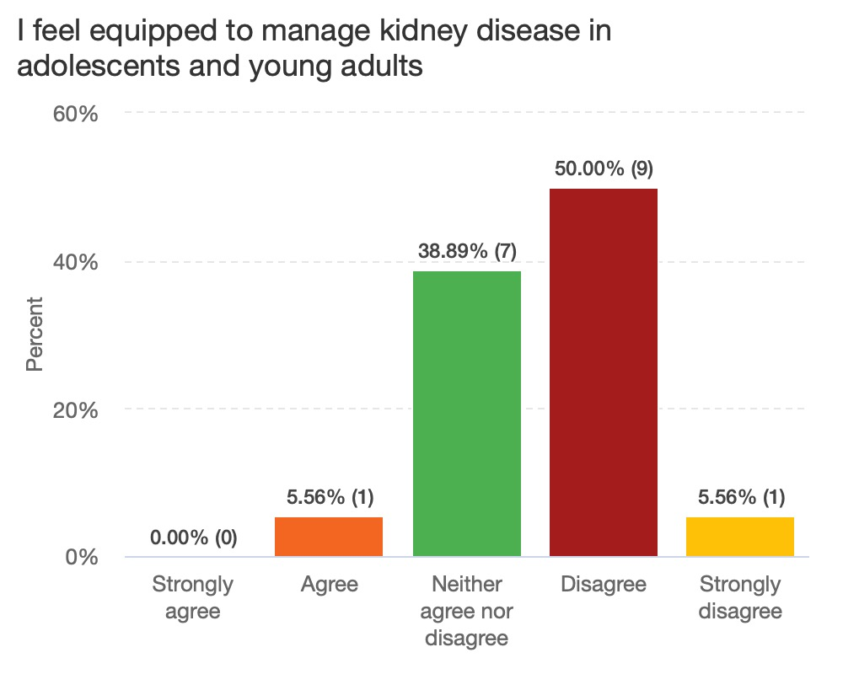
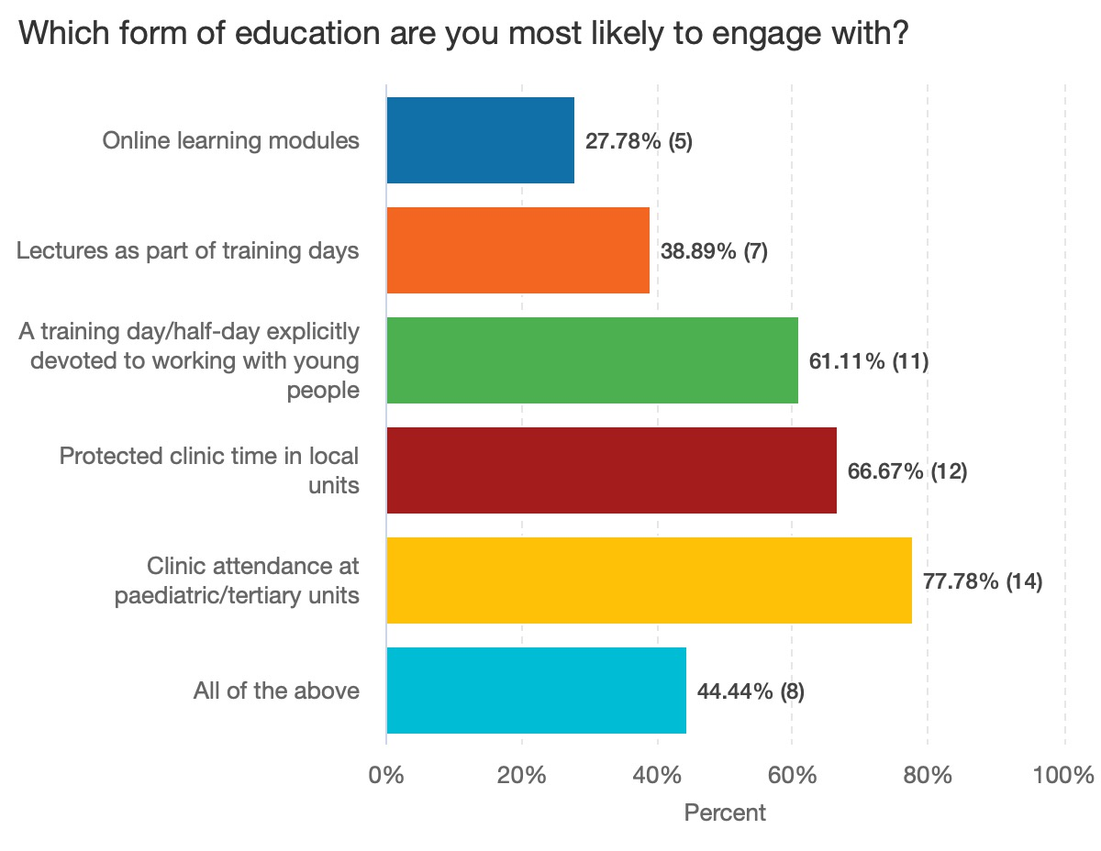
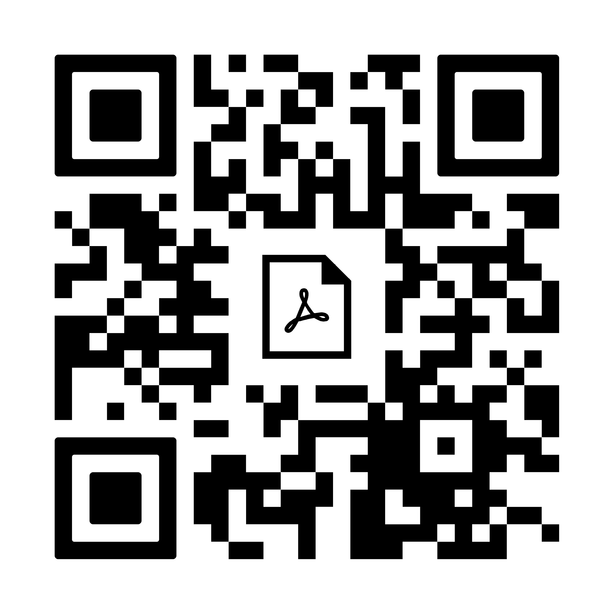
Survey of London Renal Trainees on their experience of managing young people with renal disease
Survey of London Renal Trainees on their experience of managing young people with renal disease
Survey of London Renal Trainees on their experience of managing young people with renal disease
Michelle Allan,^{1,2} Nicola Cunningham,^{1,3} Refik Gokmen^{1,4} , Joyce Popoola ^{1,3}
¹London Kidney Network, ²Barts Health NHS Trust, ³ St George’s University Hospital NHS Trust, ⁴Guy’s & St Thomas’ NHS Foundation Trust.
Introduction & Aim
Method
The transition between paediatric and adult services is a crucial period in the lives of young patients with far-reaching consequences on their long-term physical and mental health and quality of life.
The London Kidney Network Young Adult Workstream was established in December 2021 to define good care for this transition period and examine the experiences and service pathways of people aged 16-29 with kidney conditions.
To improve present and future care, we wanted to quantify the current London trainee understanding of transition, to effectively target future training and education resources.
A trainee questionnaire was designed by a subgroup consisting of a renal trainee, a renal consultant, a young adult affected by kidney disease and a project manager.
It was adapted from a published US survey, and finalised as a 22-item electronic questionnaire after feedback from the LKN Workstream.¹
It was uploaded to the online platform Smartsurvey and circulated via Health Education England London to all 90 trainees enrolled in renal medicine in London in August 2022. The questionnaire closed after monthly reminders in November 2022.
Results
Figure 1: Trainees did not feel prepared to manage kidney disease in young people
There was a 20% response rate (18 trainees). Of these, 75% were from North London, and 50% had 2-4 years of training.
All had cared for a young person at least 3-4 times per year, but only one felt confident in that role (Fig 1). Trainees reported especially low confidence discussing body health, family planning and the broader impact of kidney disease on young peoples’ social, psychological and sexual health.
All agreed that doctors have a responsibility to prepare young people to move to adult services; however, 60% felt that young people were not adequately prepared.
Only 30% had had any form of formal training or role-modelling and 83% felt there was insufficient education on this topic. Trainees indicated a preference for experiential learning (Fig 2).
Figure 2: Trainees would prefer experiential learning to online learning
Discussion
London renal trainees felt underequipped and lacked confidence when looking after young people with kidney disease, despite frequent clinical exposure.
They recognised their limitations and were keen to gain further training and experience.
The limitations of this project include
A low response rate
Potential respondent bias
The majority of respondents were from North London, so the findings shouldn't be generalised across London
We have since delivered a North London Deanery training day on the transition between paediatric and adult services.
We intend to develop training packages and repeat the survey after these interventions.
References
Scan the QR code to see the full survey report and questions
1. Sadun RE, Chung RJ, Pollock MD, Maslow GR. Lost in transition: resident and fellow training and experience caring for young adults with chronic conditions in a large United States' academic medical center. Med Educ Online 2019;24:1605783.
Contact
lkn.londonkidneynetwork@nhs.net michelle.allan2@nhs.net
@drmeallan

Slide 3
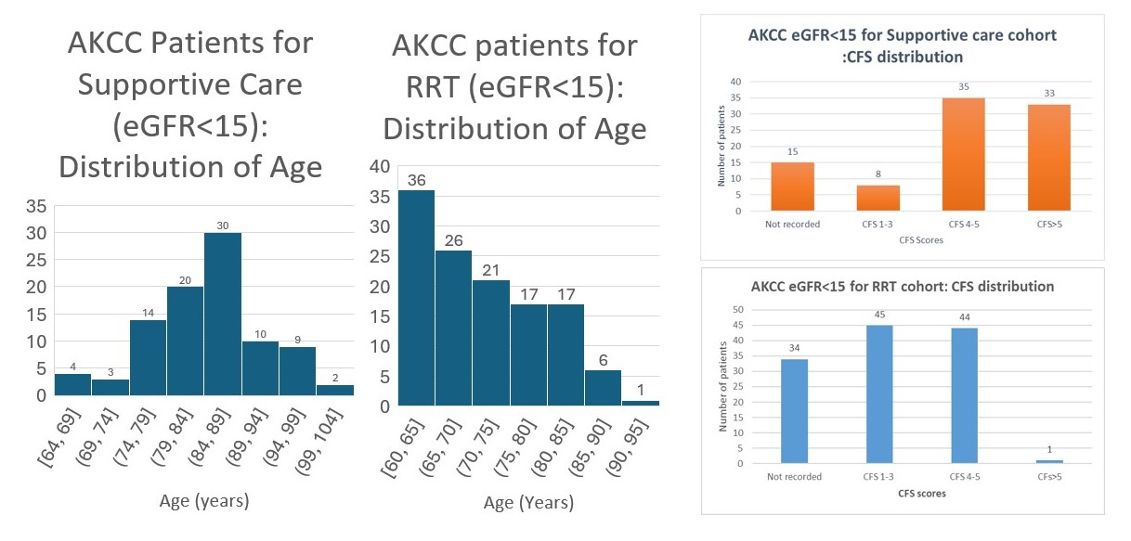
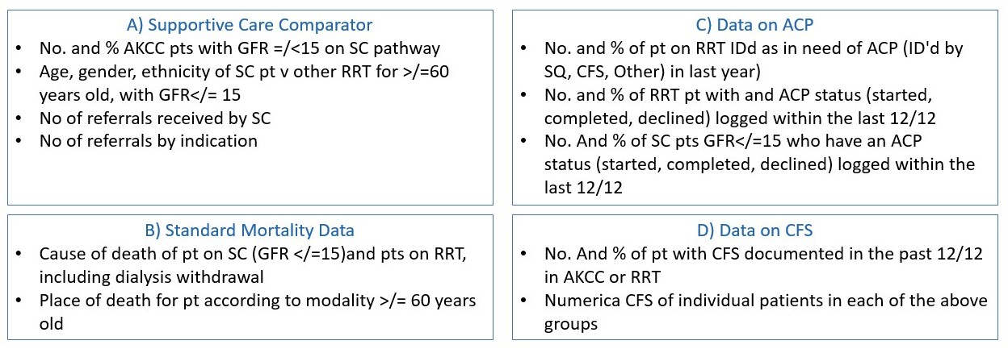
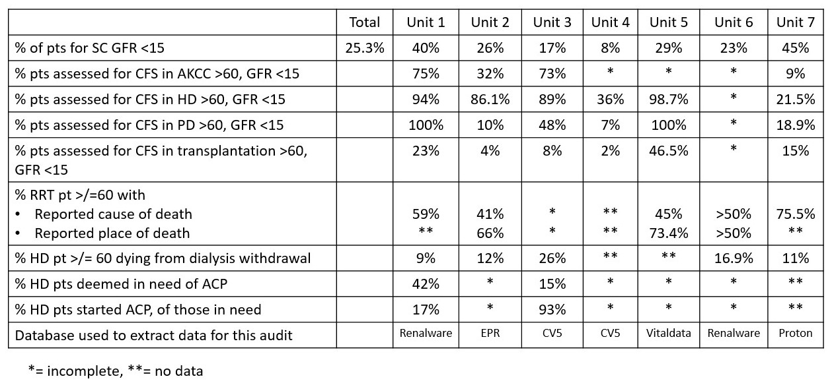
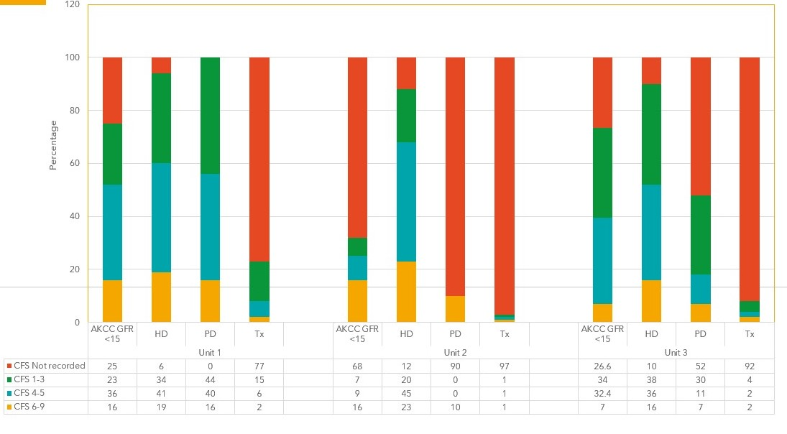
London Kidney Network Supportive Care Data Audit:
Exploring The Possibilities; Understand The Challenges
H Brown^{1,2}, S Kelly³, K Chu³, L Ancliffe⁶, R Calayag⁸, K Clarke², C Crawford⁶, N Cunningham¹, S Deoraj⁷, N Desai², D Duffield⁵, L Espiritu⁵, D Evans⁷, J Go⁴, S Kelly³, K Makwana⁷, L Nikolopoulou⁵, D Randall⁴, T Rudolphy⁸, S Saminathan², T Thompson⁵, W White⁴, D Wright⁶, K Vinen^{1,3}
¹London Kidney Network, ²Guy’s & St Thomas’ NHS Foundation Trust, ³Kings College Hospital NHS Foundation Trust,⁴Barts Health NHS Trust, ⁵Imperial College Healthcare NHS Trust, ⁶Royal Free London NHS Foundation Trust, ⁷Epsom and St Helier University Hospitals NHS Trust, ⁸St Georges University Hospitals NHS Foundation Trust
Introduction
Methods
In 2023, the London Kidney Network (LKN) performed an audit of current practice against the LKN Supportive Care (SC) Pathway (Figure 1) in all 7 renal units.
Supportive Care included those on a conservative care pathway and those receiving renal replacement therapy (RRT) for whom the predominant goals of care are functional optimisation and quality of life
There is currently no standard for assessing those with frailty to support decision making in advanced kidney care clinics (AKCC), or when caring for those managed conservatively or on RRT.
Data was collected from trust databases (Table 1). All units submitted data, However there was wide variation in data availability and extractability.
Data was a snapshot on 01/06/23, or cumulative data from 01/06/22 to 01/06/23 dependent on the data item.
Data items were agreed by the LKN SC Steering Group, to reflect the key aspects of the SC Pathway
Figure 2: Distribution of Age and CFS scores within the supportive care cohort of AKCC compared to those in RRT ≥60 years old in 1 LKN unit.
Figure 1: LKN Supportive Care Audit Data items
Table 1: Supportive care audit data collection by the 7 London Renal Units within LKN
Figure 3: Distribution of CFS scores by modality in patients ≥60 years old in the 3 units with the most complete data
Results
A) Supportive Care Services Comparator (table 1)
London renal units care for 2091 patients in AKCC with an eGFR <15 who are ≥60 years. Of these, 530 (25.3%) with an eGFR <15 were planned for SC . The proportion of patients for SC compared to the total number of patients GFR <15 varied between 8% to 45%.
Demographic data highlighted London's heterogenous populations
B) Mortality Data
The main causes of death reported were infection, cardiovascular disease, and dialysis withdrawal
Data completion rates were poor with up to 59% of causes of death unrecorded, as is consistent with the national picture.
C) Data on Advanced care planning (ACP) (table 2)
ACP data was variably recorded with HD (haemodialysis) data most complete. Transplant patients were least assessed, even in units with older transplant patients.
Of the 15-42% patients in need of ACP, 17-93% had had one started.
D) Data on Clinical Frailty Scale (CFS) Scores
CFS was variably recorded. HD data was most complete. Transplant patients were least often assessed, even in units with higher percentages of older transplant patients.
HD units with the older patients did not necessarily have the biggest burden of frailty
Despite London units describing a frail population (Fig.3), identification of ACP need was variable. Many identified as needing advanced care planning did not have an ACP status documented (17%-93%), highlighting unwarranted variation and high levels of unmet need.
Data for the majority of centres was incomplete.
Discussion
To our knowledge this is the first time a Network has collected extensive supportive care data, other than that issued by the Scottish Renal Registry.
Patients within AKCC whose chosen modality was RRT were generally younger than those choosing supportive care (Fig 2). The SC cohort were also identified as living with more frailty than those planned for RRT (Fig2). This suggests where CFS scores were recorded, they may have contributed to pathway choices within AKCC.
Not all centres in London were collecting CFS data in AKCC, prior to treatment decision. This suggests a possible missed opportunity to provide the most suitable treatment options.
This was a challenging audit, with inconsistencies and incomplete information. However, it has led to units focusing on identifying those with frailty.
Additionally, the data has influenced service prioritisation across London. All units now have additional frailty input within AKCC, with planned presence across all renal care.
Next Steps
Identify the appropriate criteria to trigger CFS documentation and ACP
Establish Joint clinics and MDMs with Gerontology and/or AHPs
Further education and spread of skills amongst staff
Prioritisation of automated data wherever possible and exploration of centralising this data
Further work with GPs to support decisions around supportive care, management of SC patients and ACP discussions
Contact heather.brown20@nhs.net
Notes:
Is conservative care and supportive care being used synonymously?
Can patients be for “SC” and on RRT if their goals of care are as per the introduction?

Slide 4
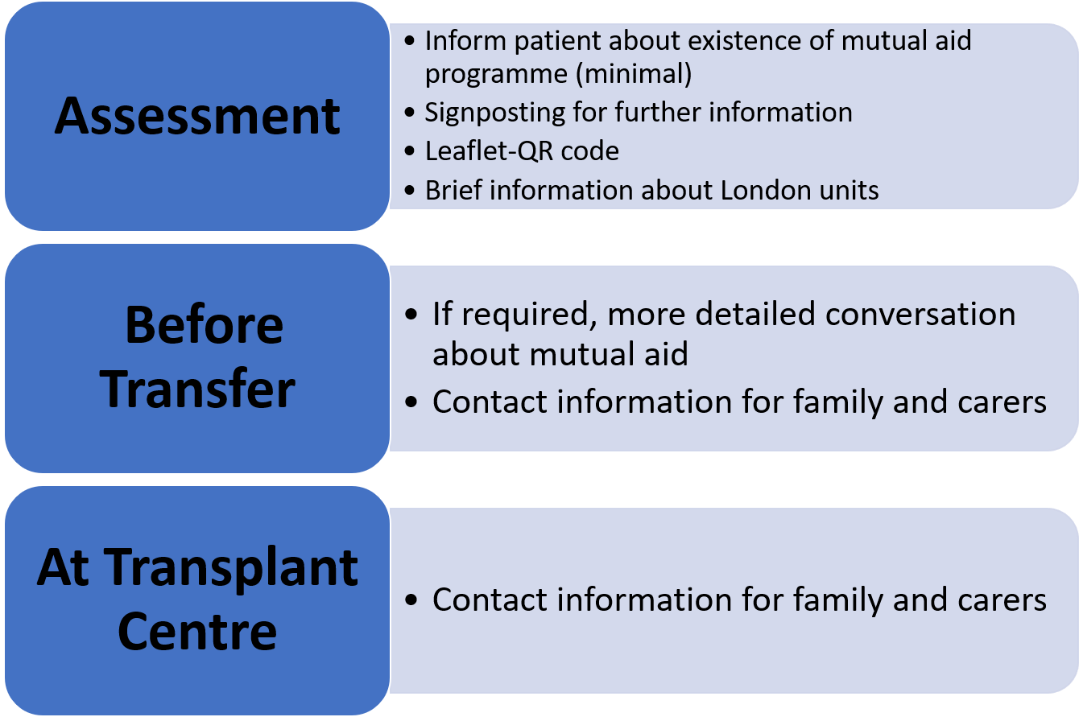
London Transplant Collaborative Patient Co-Designed Pathway for Mutual Aid
Lisa Silas,^{1,2} Sapna Shah,^{1,3} Ismail Mohamed^{1,4}
¹London Kidney Network, ²Guy’s & St Thomas’ NHS Foundation Trust, ³Kings College Hospital NHS Foundation Trust,⁴Barts Health NHS Trust
Introduction & Aim
Method
The LKN Transplant Collaborative's mutual aid programme was implemented in 2020.
It addressed an acute lack of capacity to perform deceased donor kidney transplantation, as a result of the COVID-19 pandemic.
If a DD transplant cannot be performed in one London transplant centres for logistical reasons, the mutual aid programme means is can be completed in another London centre.
Mutal Aid was designed by clinicians without patient involvement, due to the acute clinical need and circumstances of the COVID-19 pandemic.
The programme was reviewed in 2023 and feedback from patients transplanted through the mutual aid programme was sought.
Two focus groups to garner fuller patient opinion were held.
The focus groups aimed to recognise the potential for varied experiences, concerns, and insights dependent on patients' position in the transplant process.
Two virtual patient focus groups were held on Microsoft Teams
One for patients who had never received a kidney transplant (the pre-transport group)
One for those who had already received a transplant (the post transplant group).
The those invited were part of the London Kidney Network (LKN) Patient Partnership Engagement (PPE) group.
The groups were facilitated by the LKN PPE lead and attended by three co-chairs of the LKN Transplant Collaborative workstream.
The pre-transplant group included four patients:
One on peritoneal dialysis.
Three pre-dialysis patients, one of whom was a patient representative from the LKN Young Adult Workstream.
Two London units were represented.
The post-transplant group included eight patients:
All had received a transplant.
All five London transplanting centres were represented.
Both focus groups used the same structured format
A presentation from a surgeon
Open discussions about the participants' reactions to mutual aid.
Both groups were asked
what information they would like to receive about the mutual aid programme
what information would be helpful,
when they would like to receive the information
how they would like it to be delivered.
Results
None of the patients in either group were aware that the mutual aid programme existed before the focus groups.
All saw it as a positive initiative.
Both groups wanted reassurance that information shared between units was done so securely and that it was comprehensive enough to ensure their safety in an unfamiliar environment.
The pre-transplant group initally thought they would like detailed information about the programme, and the hospitals they could be operated in
On reflection, they realised that the possibility of them requiring mutual aid was low, so they ultimately came to a similar conclusion to the post-transplant group (Graph 1)
Graph 1: Table shows a summary of the discussion outcomes from both groups
Discussion
As a result of our focus groups and listening to patients, we can improve the service we offer.
Greater engagement and better shared decision-making leads to better outcomes; both experientially and clinically.
By actively engaging with patients we intend to build on the culture of shared learning within the LKN.
When patients demonstrate their investment and their voices are heard, it gives us the opportunity to get greater buy-in from other stakeholders.
Contacts: lisa.silas@gstt.nhs.uk sapna.shah@nhs.net Ismail.Mohamed1@nhs.net

Slide 5
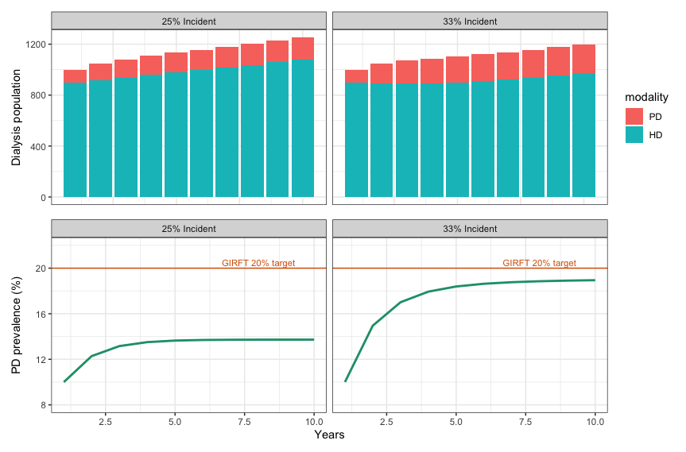
Modelling peritoneal dialysis starts to support
home dialysis growth
Richard Corbett^{1,2}, Katie Durman^{1,3}, Mariza Procopio¹, Bhrigu Sood^{1,4}, Damien Ashby², Edwina Brown², Peter Wilson¹
¹London Kidney Network, ²Imperial College Healthcare NHS Foundation Trust, ³Barts Health NHS Trust, ⁴Epsom and St Helier University Hospitals
Introduction & Aim
Results
Sustainable growth in home dialysis modalities is a focus of the Renal Services Transformation Program.
The Getting It Right First Time (GIRFT) program identified that all renal units should have access to adequate training facilities and staffing for home dialysis for at least 20% of their prevalent dialysis on home dialysis within 12 months of report publication.
Peritoneal dialysis (PD) is used as the predominant home dialysis treatment but patients in the UK have a shorter time on PD than many countries due to high transplantation rates.
In order to explore how the 20% prevalent population might be achieved using PD, simulations using real-world data were created.
In centres with an incident PD population of 25% of all dialysis starts each year and assuming median PD and HD time on therapy to be 1.7 and 3.7 years respectively (Figure 1):
a steady state was achieved after four years, with a prevalent 14% PD population.
when the proportion of dialysis starts on PD is increased to 33%, after six years a prevalent 19% population is achieved.
As might be expected the wide variation in time on PD in the UK strongly affects PD prevalence (Figure 2).
In centres with shorter time on PD (0.8 years), PD prevalence is lower:
10% at 2 years with 33% incident PD population
7% at 3 years with a 25% incident PD population
Centres with longer time on PD (2.9 years) PD prevalence is higher:
21% with a 25% incident PD population
28% with a 33% incident PD population
Methods
Modelling simulations were created in Excel to explore prevalent dialysis populations over several years.
An initial population size of 1000 patients with a 10% PD prevalence was used. An annual incident population of 350 dialysis patients with a conservative annual 2% growth was assumed.
Previous work has identified that in units where access to PD is optimised and patients are allowed free choice of dialysis modality, approximately 33% will start dialysis on PD¹.
Finally, time on each dialysis modality was included; for PD this used PDOPPS² published data, where the UK has a median time of 1.7 years (interquartile range, 0.8-2.9). Local data for HD was used to inform the modelling.
Figure 2: Effect of PD incidence rates (%) and time on PD (years) to overall PD prevalence
Figure 1: Steady state modelling of an increase in PD incidence to either 25% or 33% of all dialysis starts assuming mean time on therapy of peritoneal dialysis (PD) of 1.7 years and on haemodialysis (HD) of 3.7 years. Annual growth of 2% included
Discussion
Assuming a stable dialysis incident rate and time on treatment, PD prevalence will not continue to grow indefinitely but reaches a steady-state after a period of several years.
Data from this model can be used to inform demand and capacity models required for both PD access and training, to ensure patients who choose PD can start on their therapy of choice.
Centres with longer time on PD and therefore a higher PD prevalence should ensure that this does not arise by limiting access to transplantation.
Equally the short times on PD in some centres reflects the need to focus on maintaining standards of care, including low-levels of peritonitis to support growth in PD.
Ultimately, to achieve sustainable growth in home dialysis, both access to HHD and PD need to be optimised.
References
Blake PG, Quinn RR, Oliver MJ: Peritoneal dialysis and the process of modality selection. Perit. Dial. Int. 33: 233–41, 2013
Lambie M, Zhao J, McCullough K, Davies SJ, Kawanishi H, Johnson DW, et al.: Variation in Peritoneal Dialysis Time on Therapy by Country Results from the Peritoneal Dialysis Outcomes and Practice Patterns Study. Clin. J. Am. Soc. Nephrol. 17: 861–871, 2022
Contact
rwcorbett@nhs.net

Slide 6
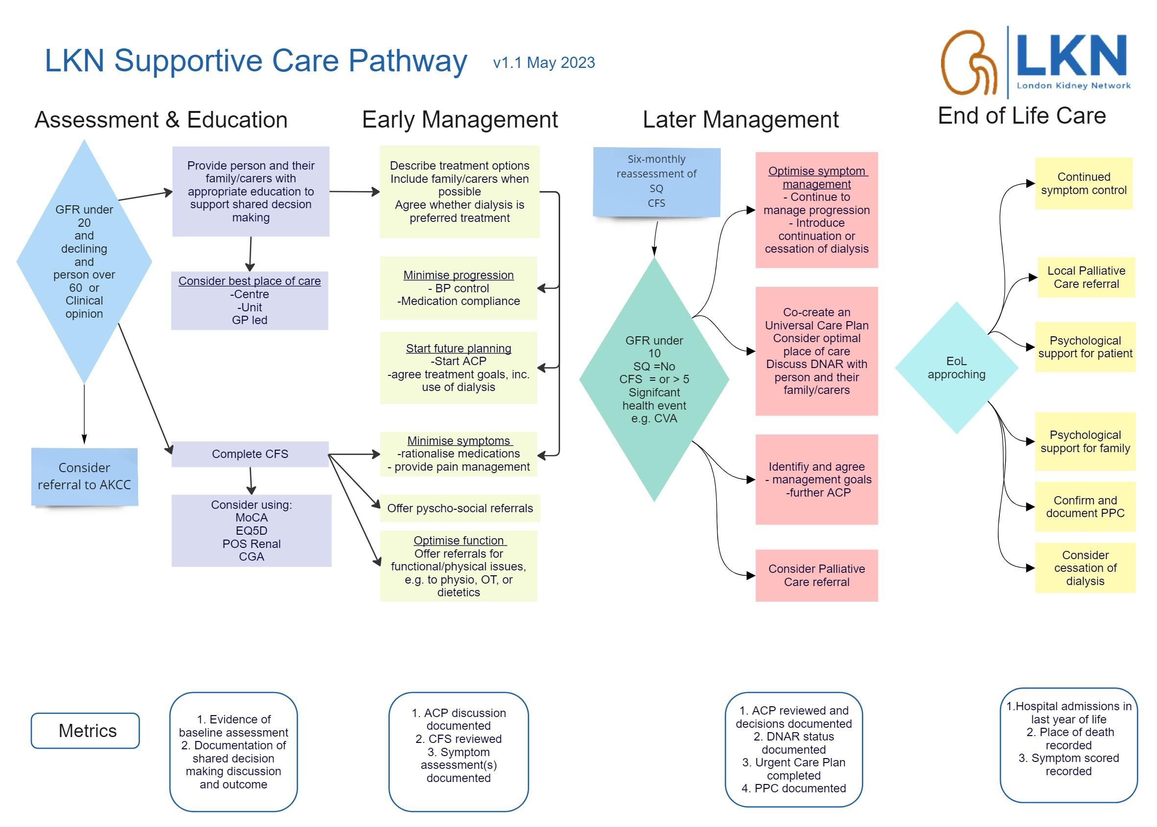
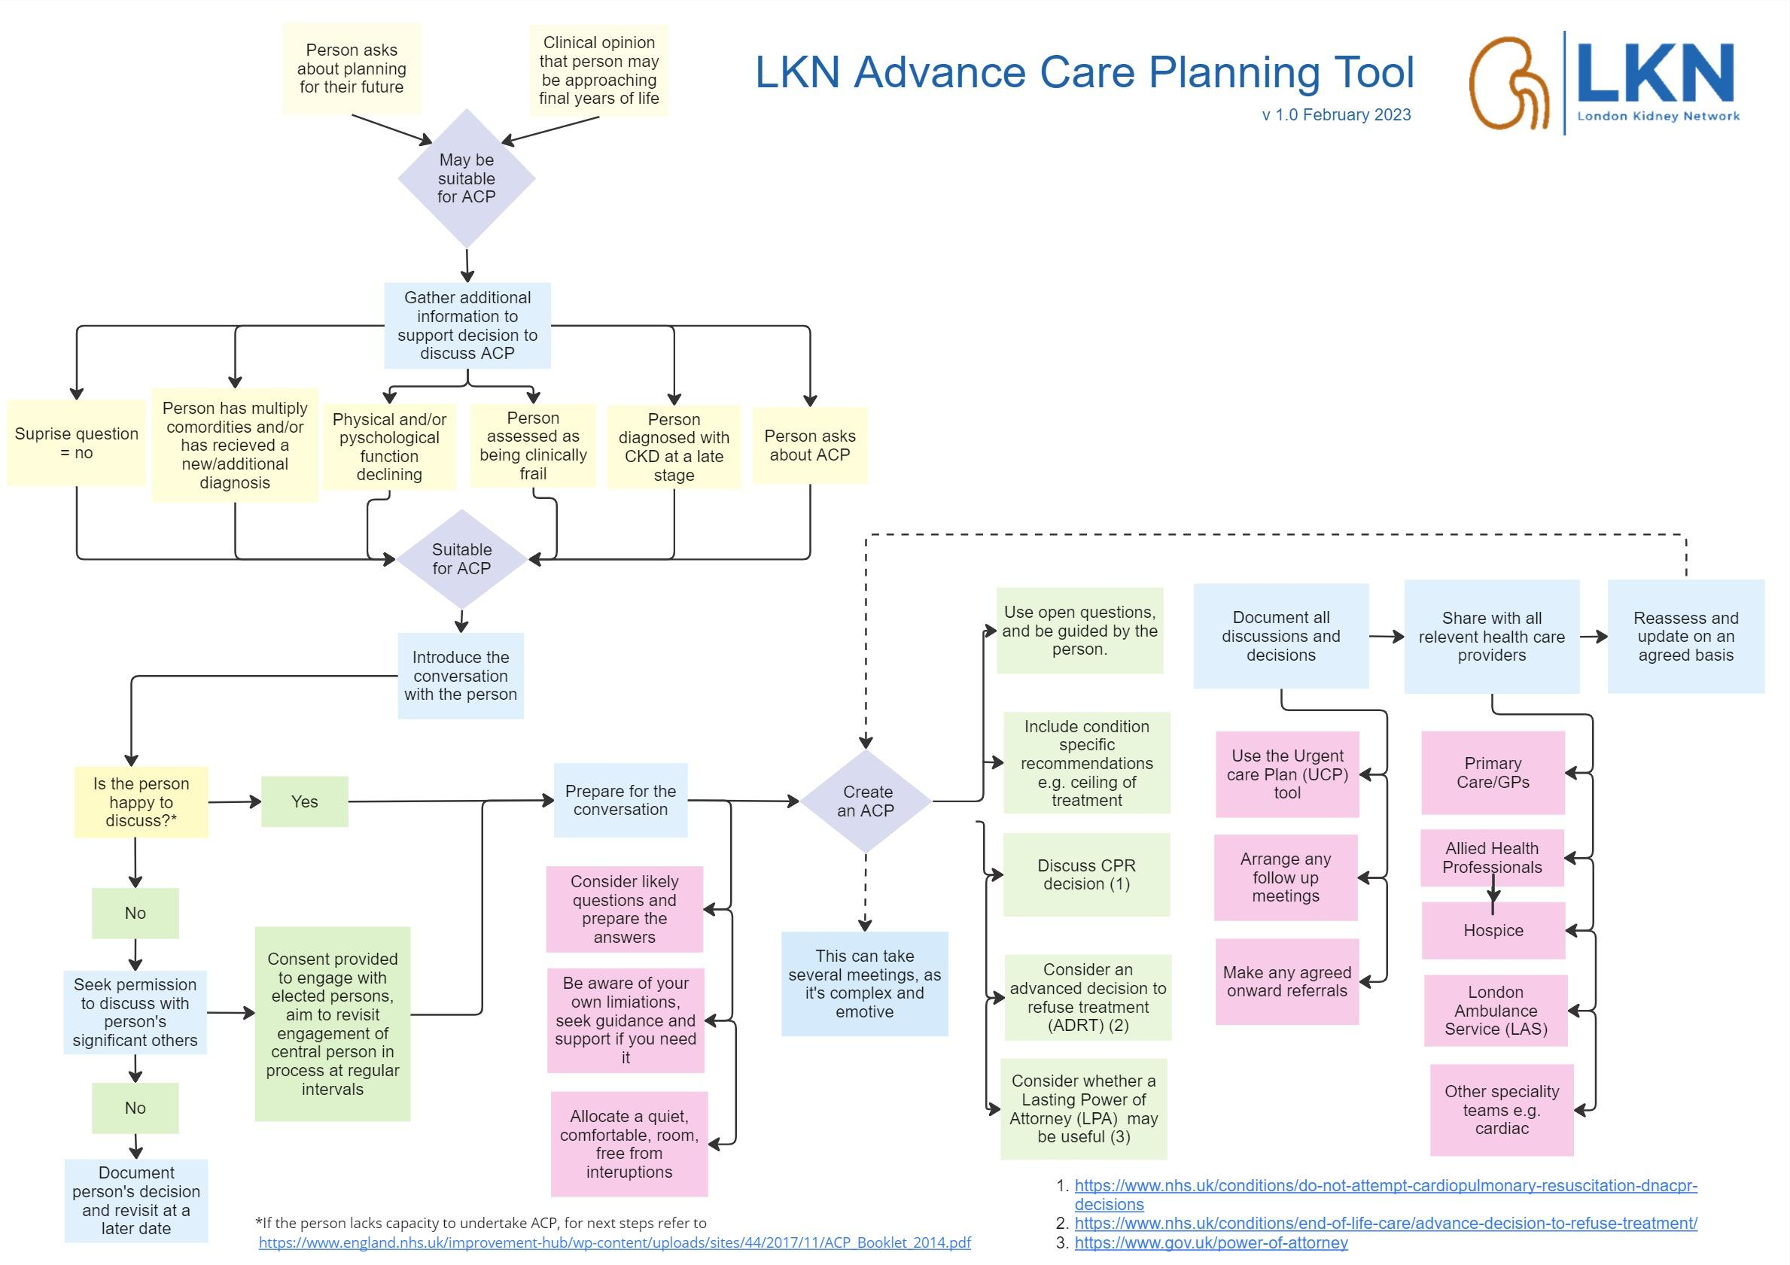
Collaborative working through a renal Network to lead improvements in Supportive Care across London
N Cunningham¹, H Brown^{1,2}, S Kelly³, K Chu³, L Ancliffe⁶, R Calayag⁸, K Clarke², C Crawford⁶, S Deoraj⁷, N Desai², D Duffield⁵, L Espiritu⁵, D Evans⁷, J Go⁴, S Kelly³, K Makwana⁷, L Nikolopoulou⁵, D Randall⁴, T Rudolphy⁸, S Saminathan², T Thompson⁵, W White⁴, D Wright⁶, K Vinen^{1,3}
¹London Kidney Network, ²Guy’s & St Thomas’ NHS Foundation Trust, ³Kings College Hospital NHS Foundation Trust,⁴Barts Health NHS Trust, ⁵Imperial College Healthcare NHS Trust, ⁶Royal Free London NHS Foundation Trust, ⁷Epsom and St Helier University Hospitals NHS Trust, ⁸St Georges University Hospitals NHS Foundation Trust
Introduction
Method
The London Kidney Network aims to deliver improvements in kidney care across 27% of England's RRT (renal replacement therapy) population
With an aging population, optimisation of those following an active non-dialysis pathway and those on RRT for whom functionality and quality of life have become priorities (together called supportive care (SC)) is key.
A SC workstream was created and led by 0.2WTE Clinical Chairs, alongside project management support.
Initial aims were to
address unwarranted variation by creating locally agreed pathways (fig.1 and fig. 2), community care networks and a toolkit of educational resources for patients and staff.
define and monitor pilot outcome measures for an area of care without current nationally mandated data collection or agreed audit standards.
A Steering Group to drive SC strategy with a wider group acting as advisors for specific work was established. Members represented
All 7 london and surrey renal units
The multi-professional team; Doctors, Nurses, and Allied health professionals
Renal, geriatric, palliative and primary care experts, as well as patients
The Steering Group met six-weekly providing oversight, challenge, problem solving and peer review of progress. This enabled rapid progress using wide specialist knowledge and expertise.
Early meetings encouraged sharing and discussion of ideas, creation of a common vision and forging of strong new relationships.
Working groups tackled each item, with direction from the Steering Group
Initial priorities were to:
Agree a definition for SC
Develop renal SC pathway and ACP planning tool for use across London
Develop training and education materials on SC and advanced care planning (ACP) for
Renal specialist health professionals
GPs for use in primary care, and
Patients offered SC as a treatment option.
The Chairs visited each Unit leading ‘deep dive’ reviews of successes and challenges faced across London. This helped focus priorities, and enabled sharing of innovation.
A core set of metrics to measure activity against the pathway were agreed
Practice was audited using the metrics.
Fig 1: LKN Supportive Care Pathway
Fig. 2: LKN Advanced Care Planning Tool
Results
The London SC Pathway and ACP pathways launched in February 2023.
A GP training module was developed, and a webinar delivered in September 2023 https://youtu.be/SkzRvTLCCJ8
A SC e-module launched in October 2023 (QR Code 1) Pan-London metrics were agreed, and data collected across all London units. An audit was presented in December 2023
Two patient information booklets, “Making Your Treatment Decision” (QR Code 2) and “Living Well without Dialysis” (QR Code 3) were created
Increased visibility for SC has led to new London funding for a 2-year programme of work led by the six ICS' directed towards this area of care.
Discussion
A collaborative pan-London approach has enabled advancement in standardising and optimising SC.
Units have shared achievements and sought peer support to address gaps in services.
Future work will refine metrics and data definitions following the audit, better align clinical practice and create symptom guidance for GPs.
Workforce variation, models of working with care of elderly colleagues and further work on ACP and patient reported outcomes will follow.
QR Code 1: Renal Supportive Care Training Module
QR Code 2: Making your treatment decision booklet
QR Code 3: Living well without dialysis booklet
Contact
Nicola.cunningham14@nhs.net Londonkidneynetwork.nhs.uk

